Slide 1
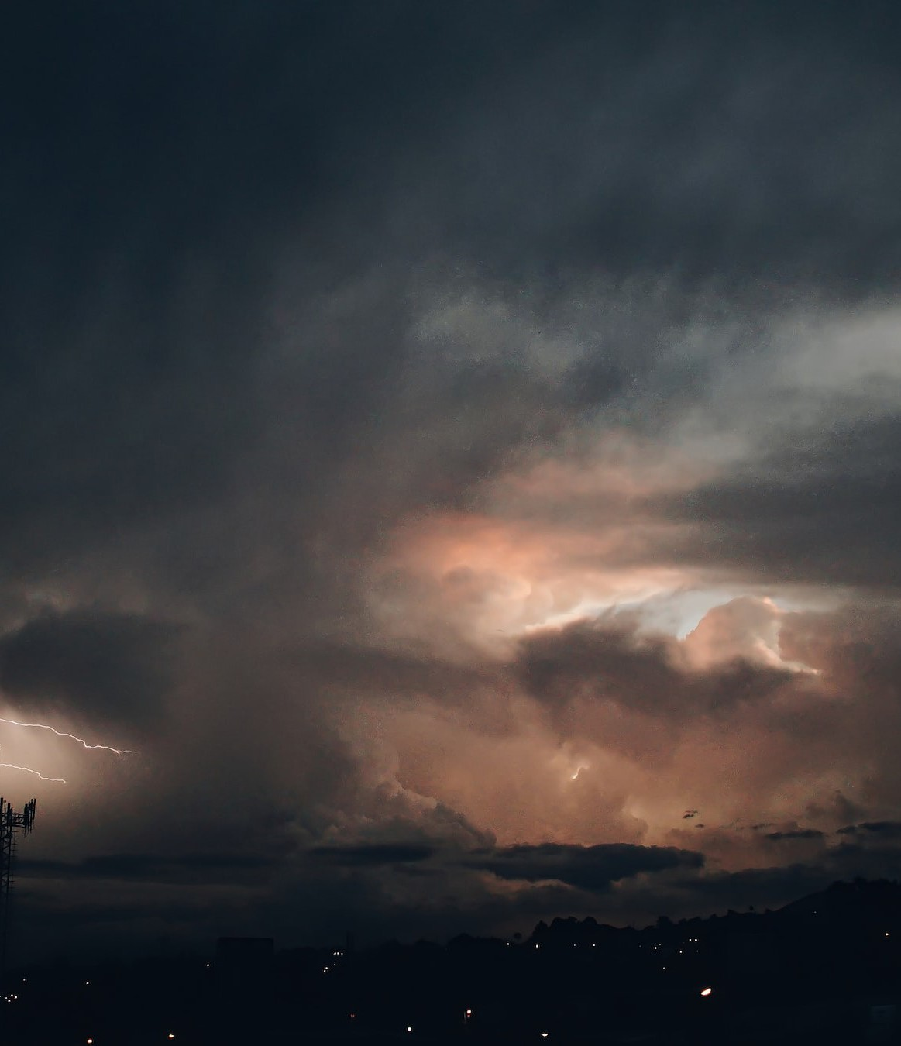
TEMA: project
presentation
April 18, 2024
This project has received funding from the European Union’s HE research and innovation programme under the grant agreement No. 101093003

Slide 2
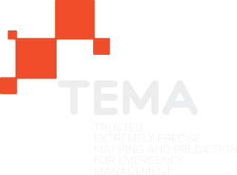
Motivation

Slide 3
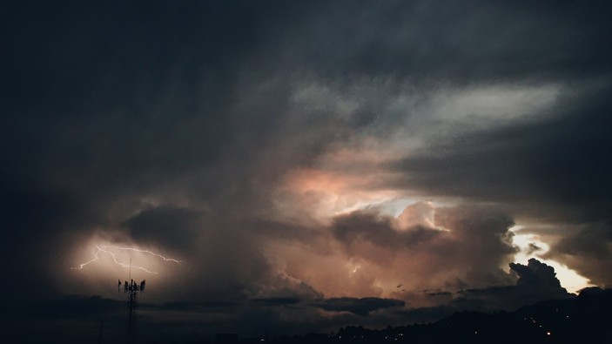
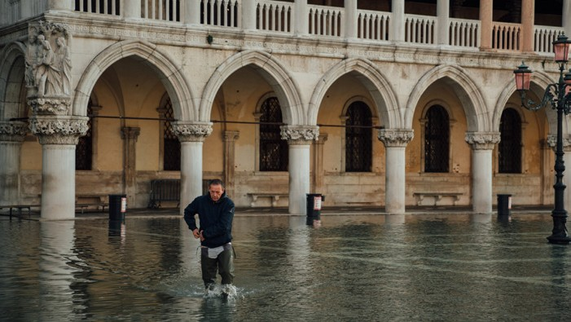
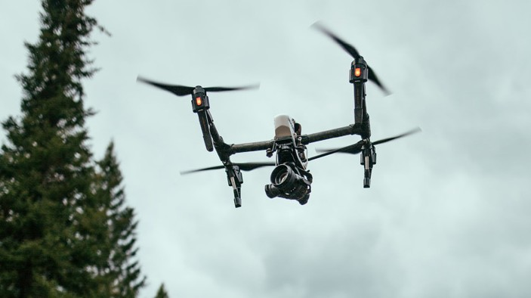
Project’s Motivation
Climate change is leading EU countries to experience increasingly frequent and damaging adverse climatic events, such as large fires and flooding. The impact of these events is expected to make EU increasingly vulnerable due to the magnitude and frequency with which they will occur in the coming years.
According to the Emergency Events Database (EM-DAT), natural hazards have cost about 3 trillion dollars of economic destruction and 1.3 million casualties, with more than 4.4 billion people injured between 1998 and 2017.
In Europe, between 1980 and 2020, disasters affected nearly 50 million people and caused economic losses of roughly €12 billion per year.
Technologies related AI, XAI and XR, which are useful for solving NDM (Natural Disaster Management) problems, have reached a very high degree
of maturity compared to just a few years ago.

Slide 4
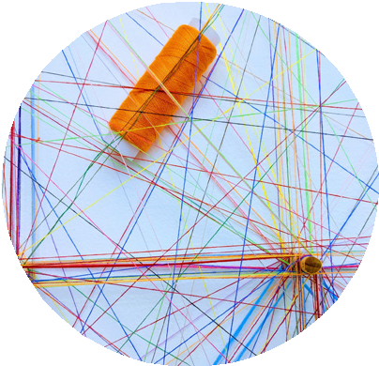
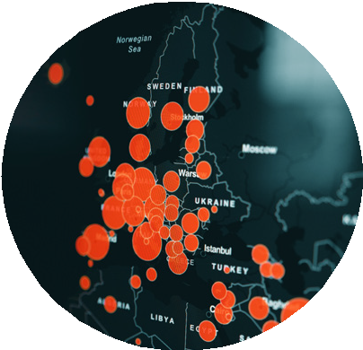
Needs / What brought us here
1 Trustworthy information:
access to heterogeneous, accurate, and reliable data is crucial to providing useful information to first responders and public protection and disaster relief
2 Transferability:
a solution provided with cloud and edge computing infrastructure can offer scalability, performance, storage, ubiquitous access and security enabling global transferability of services and products to other geographic regions and disaster types
3 Scenario prevision:
the use of cutting-edge technologies and data analysis can increase the quality, precision, and completeness of the situational picture, particularly in sub-urban and more densely populated areas, and elaborate response strategies

Slide 5
The Project
Vision

Slide 6
The Vision
TEMA aims to develop beyond-state-of-the-art technologies for facilitating
Natural Disaster Management, by dynamically exploiting data sources and Artificial Intelligence technologies in order to provide an accurate assessment
of an evolving crisis situation.
The goal is to deliver a technical solution that is supportive in disaster response and management by bringing situational data to relevant end-users, enabling transferability to tackle different disaster types in various geographic regions, thus providing the relevant information that can help make the best possible operative decisions.

Slide 7
Objectives

Slide 8
Main Objective
TEMA will be an AI-enabled NDM platform which will be validated and demonstrated
in two socially important cases: forest fires and floods.
Due to the scale and diversity of the employed extreme data and their powerful analysis, TEMA will offer precise semantic 3D area mapping and NDM event prediction over a longer time period, by taking into account all related uncertainty factors.
TEMA tools will allow precise replication and modeling of real NDM events,
while considering quality standards and assessment criteria for simulated NDM data. Advanced AR-enabled TEMA visualization will be interactive, intuitive and accessible. It will allow human operators to understand complex NDM phenomena and easily evaluate alternative response strategies, by smart selection of platform parameters and by novel ways of combining heterogeneous (visual and non-visual) data and/or AR.
Moreover, TEMA will provide a scalable and efficient NDM-Analytics-as-a-Service
(NDM-AaaS) for making the developed advanced analytics tools available over the cloud.

Slide 9
Specific Objectives
Improve and accelerate
extreme data analytics,
by increasing trustworthiness, accuracy and responsiveness of extreme data analysis algorithms;
Improve Natural Disaster Management
using new digital technologies and extreme data analytics;
Improve and accelerate
emergency phenomenon modeling, evolution predictions, simulation and interactive visualization.

Slide 10
Results
and Benefits

Slide 11
Key Results
Advanced real-time visual and social media analytics software
Advanced real-time visual and social media analytics software
Advanced information fusion software for heterogeneous data sources Novel XAI algorithms for multimodal analysis
Advanced federated analytics middleware for edge-to-cloud continuum paradigms
Near-real-time forest fire and flood modeling software
Advanced visual privacy preservation software

Slide 12
Key Results
Advanced response planning software for optimal sensor placement
Rapid and robust Digital Twin and geovisual analytics software NDM-AaaS software
University and continuing (e-)education content
A set of proposed technical standards for extreme data analysis 4 Pilot Trials in disaster management scenarios.

Slide 13
Related to edge
Developing a solution for the harmonisation and seamless sharing and use of data coming from heterogeneous sources to be analysed in real-time
The solution runs across the edge-to-cloud continuum, more specifically computation and storing are extended towards the edge in a federated manner (when possible) for engine optimisation (reduced latency)
The edge will be the various equipments of the emergency response actors (distributed on various locations including the mobile operational centresdvanced response planning software for optimal sensor placement

Slide 14
Thank you for your attention

