Slide 1
TRANSPARENT APPLICATION DEPLOYMENT IN A SECURE, ACCELERATED AND COGNITIVE CLOUD CONTINUUM
SERRANO Overview
Call identifier: ICT-40-20 on “Cloud Computing: towards a smart cloud computing continuum”
Project Type: Research & Innovation Action (RIA)
Prof. Emmanouel (Manos) Varvarigos
Dr. Aristotelis Kretsis
Dr. Panagiotis Kokkinos
Institute of Communication and Computer Systems – ICCS

Slide 2
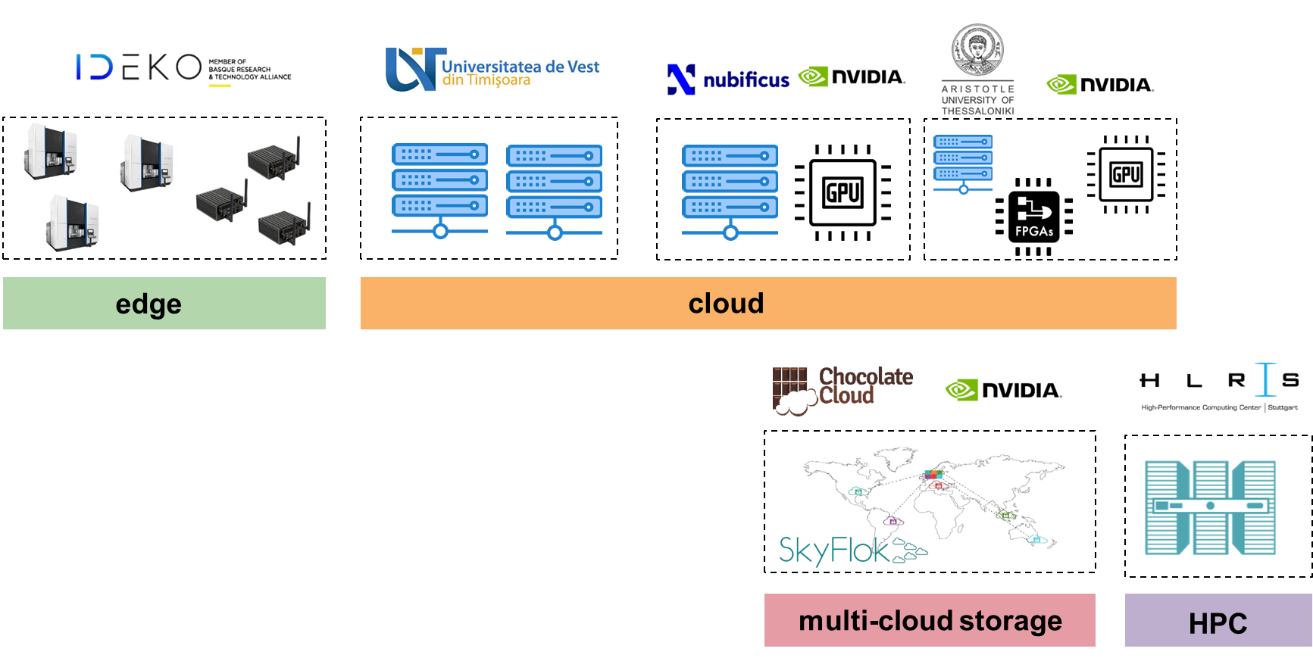
SERRANO Platform
Targets infrastructures consisting of edge, cloud and HPC resources and builds a continuum

Slide 3
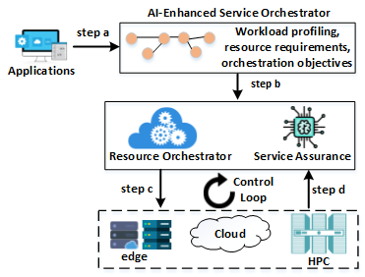
SERRANO lifecycle
SERRANO platform adopts a lifecycle methodology to facilitate application deployment and cognitive resource orchestration in the edge-cloud-HPC continuum
Lifecycle:
Step a, b: Transparent application deployment and the translation from generic intents to specific objectives
Step c, d: Continuous and autonomous allocation and adaptation of resources and applications

Slide 4
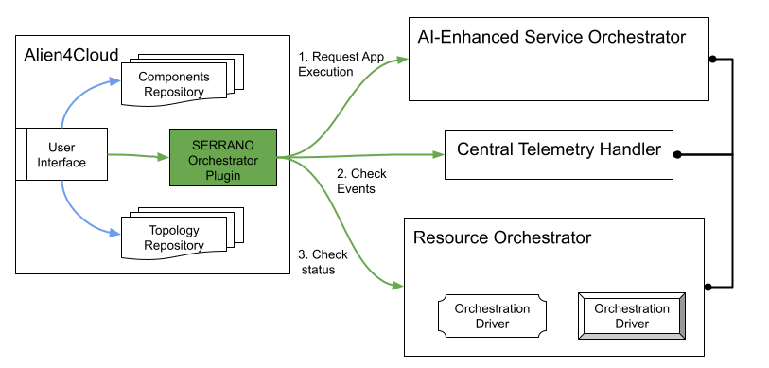
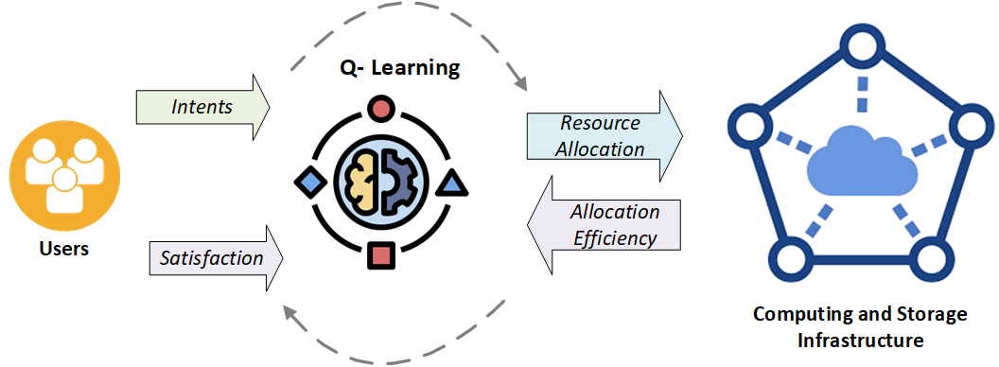
SERRANO Platform
Enables transparent application deployment, through an abstraction layer
Implement :
UI based mechanisms for application deployment description and for the specification of infrastructure-agnostic intents
Orchestrator Plugin translates intents from the TOSCA specification to the SERRANO specific Application and Resource models and to Kubernetes descriptors (YAML)
AI-Enhanced Service Orchestrator (AISO) that use these models and creates deployment objectives based on the intents
AI/ML algorithms that translate intents to infrastructure-aware objectives and policies

Slide 5
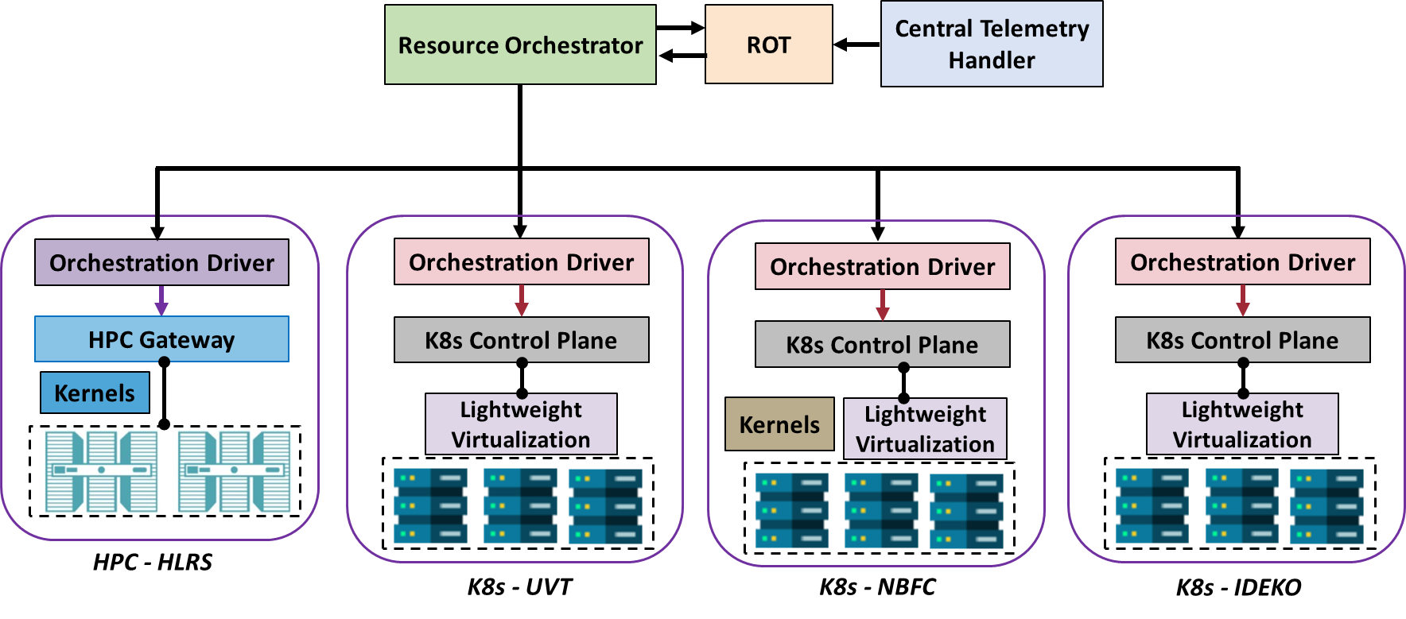
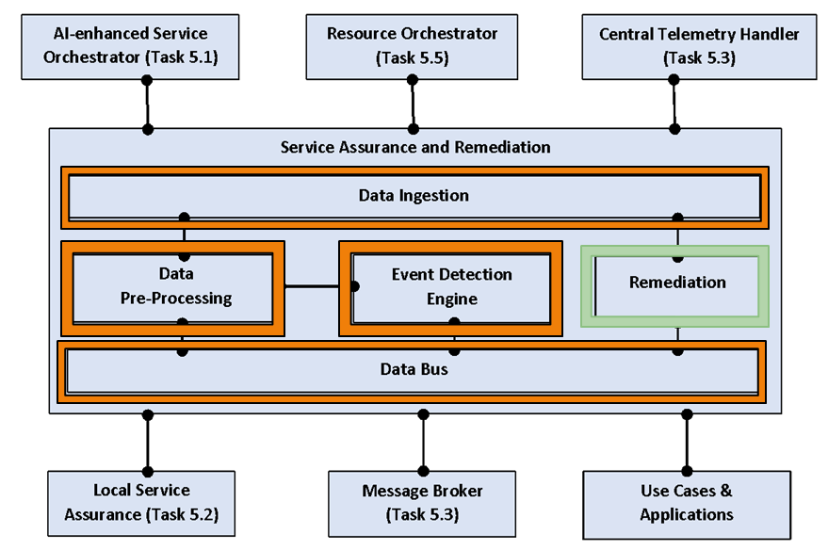
SERRANO platform
Adapts continuously and autonomously the continuum
The Resource Orchestrator, the Resource Optimisation Toolkit (ROT) and the Telemetry Framework enable the orchestration of the continuum using AI-based mechanisms
Two stage approach for the resource orchestration:
SERRANO Resource Orchestrator
Local orchestration mechanisms based on K8s
The SERRANO HPC Gateway service interacts with HPC systems
The Service Assurance and Remediation Service (SAR) and the Event detection Engine (EDE) enable the detection of events and the re-optimization of the infrastructure

Slide 6
SERRANO platform
SERRANO platform introduces and integrates a number of key innovations:
SERRANO Storage Service enables secure storage in the edge and in the cloud, using erasure coding
NVIDIA’s commercial off-the-shelf Data Processing Units (DPUs) were used for accelerated data processing, reducing CPU overhead through TLS-offloading
A lightweight hypervisor that runs unikernels as functions, was developed, so as to isolate instances and to reduce the attack surface of the running applications
Developed HW and SW accelerated kernels (for FPGA, GPU, HPC), based on the UC applications, utilizing transprecision and approximation computing
vAccel framework was extended, facilitating access to hardware accelerators by applications that run as containerized functions
OpenFaaS serverless framework was integrated into the platform

Slide 7
Use Case Demonstrations
UC1 - Secure Storage Use Case: Secure, high-performance storage of files
HW-assisted TLS offloading reduces the total number of CPU cycles
Serve a large number of parallel client requests with high throughput
UC2 - The Fintech Use Case: Dynamic Portfolio Optimization (DPO) application
FPGA and GPU hw-accelerators and HPC resources are utilized
Increase the number of generated portfolios that have a higher expected return and maintain the lowest possible risk
Reduce cloud costs by using a hybrid edge-cloud infrastructure
UC3 - Anomaly Detection in Manufacturing Settings: Detect machine anomalies, without stopping the machines
Timely process of streaming data leveraging SERRANO’s kernel acceleration (FPGA, GPU) mechanisms
Perform continuous health assessment
Predict imminent failures with enough time to avoid severe machine failures

Slide 8
Thank you!
Prof. Emmanouel (Manos) Varvarigos
Dr. Aristotelis Kretsis
Dr. Panagiotis Kokkinos
Institute of Communication and Computer Systems – ICCS
Visit our website! https://ict-serrano.eu
The research leading to these results has received funding from the EC HORIZON 2020 SERRANO project, under grant agreement number 101017168

