Slide 1
Programming trustworthy Infrastructure As Code in a sEcuRE framework [PIACERE]
March 26
EUCloudEdgeIoT.eu RIA Showcase
WHY?
WHAT?
HOW?

Slide 3
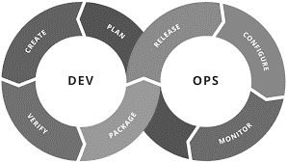
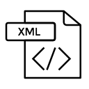
PIACERE CONTEXT
WHAT?
Virtualization
Cloud Computing Continuum
(Sec) DevOps philosophy
8 partners from 4 European countries
1st December 2020 – 30th November 2023
Templates
Scripts
Policies
Network elements
Cloud infrastructure
Infrastructure as Code (IaC)
Enables the automation of several deployment, configuration and management tasks that otherwise would have to be performed manually by an operator

Slide 4
Context and motivation: general challenges
WHY?
Large variety of competing tools
Focused on a single set of automation steps
(Only) Cloud Computing oriented
Deficient Trustworthiness and security coverage
Partial coverage of the whole DevOps process

Slide 5
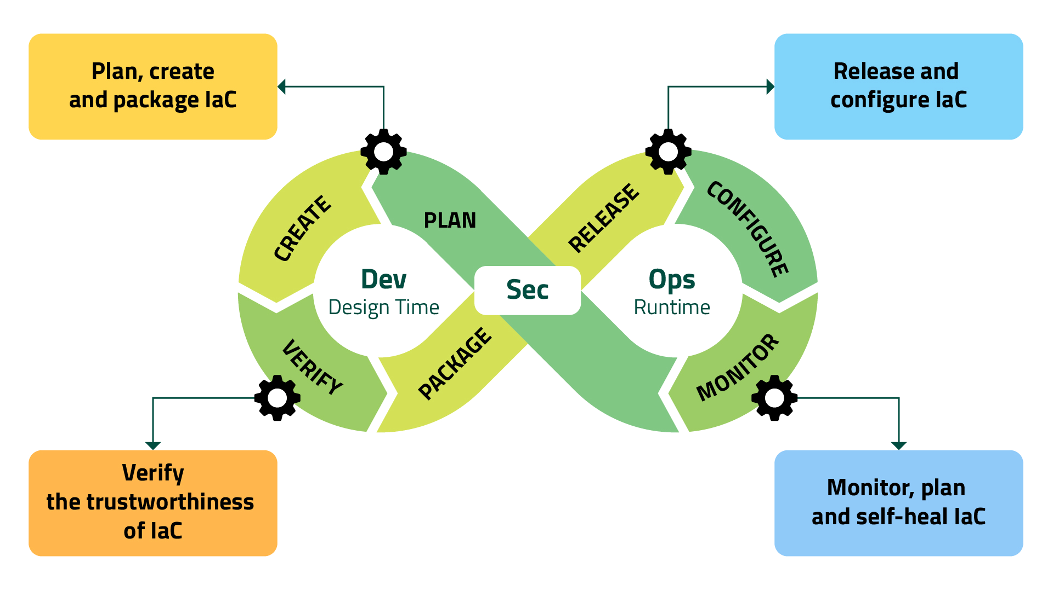
DOML – domain specific language
IDE
Model checker
IaC Optim. Platform + catalogue
IaC Code Generator (Terraform, Ansible, …)
PIACERE runtime controller
Canary sandbox environment
IaC Execution manager
(Security) monitoring
Self-learning
Self-healing
IaC security inspector
Component security inspector

Slide 6
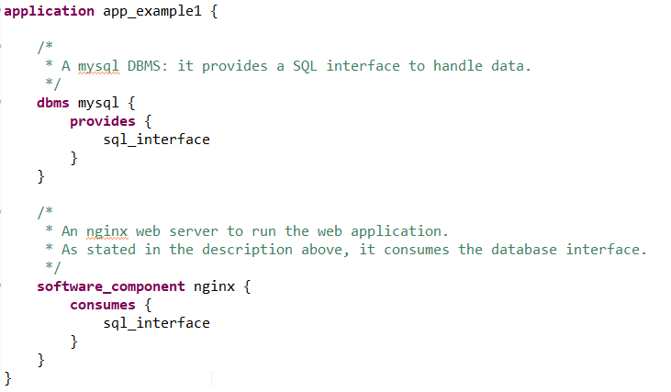
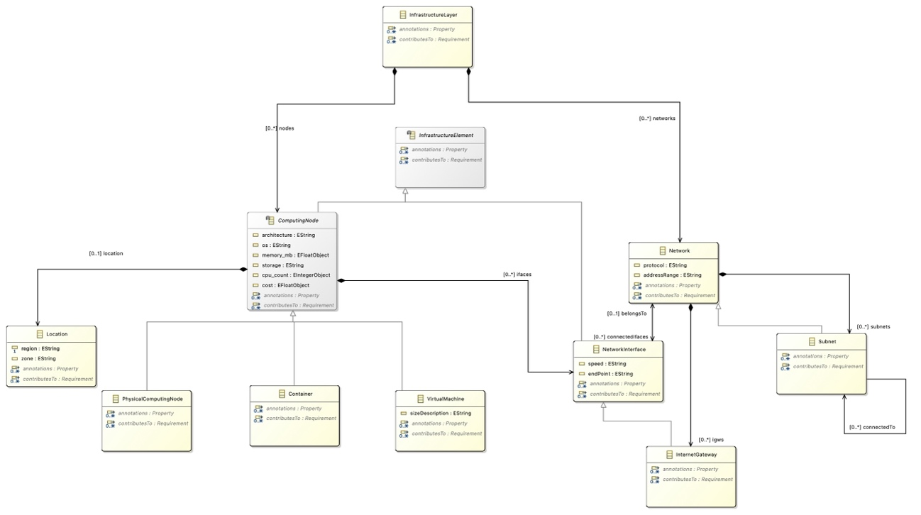
WHAT?
DevSecOps Modelling Language
Improve the ability of (non-)expert DevSecOps teams to model provisioning, deployment and configuration through the abstraction of execution environments
PERFORMANCE IN LOC
UNIFIED DEPLOYMENT CONFIGURATION
SOLVED REQUIREMENT SPECIFICATION
^{www.piacere-project.eu}
^{@PIACEREproject}
^{@PIACERE project H2020}
^{@PIACERE project}
^{@PIACERE}
^{@PIACERE}

Slide 7
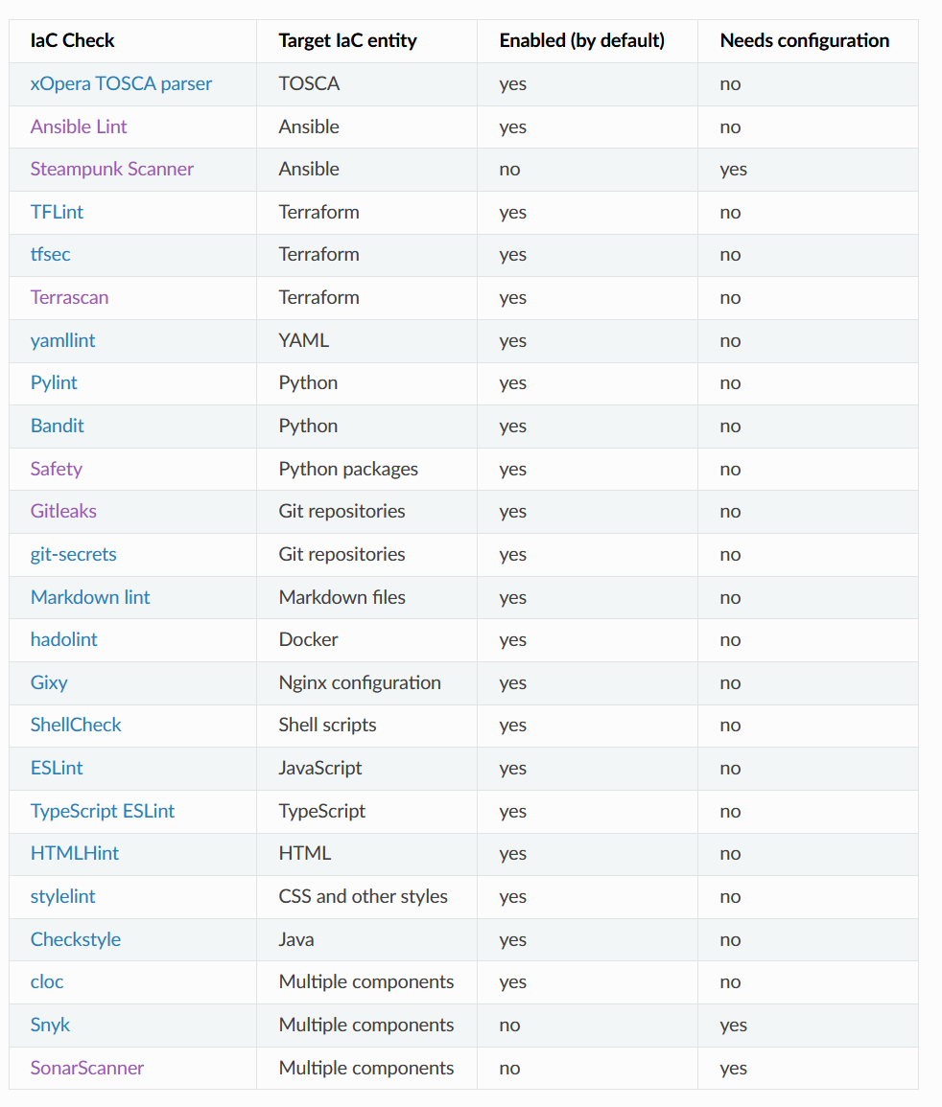
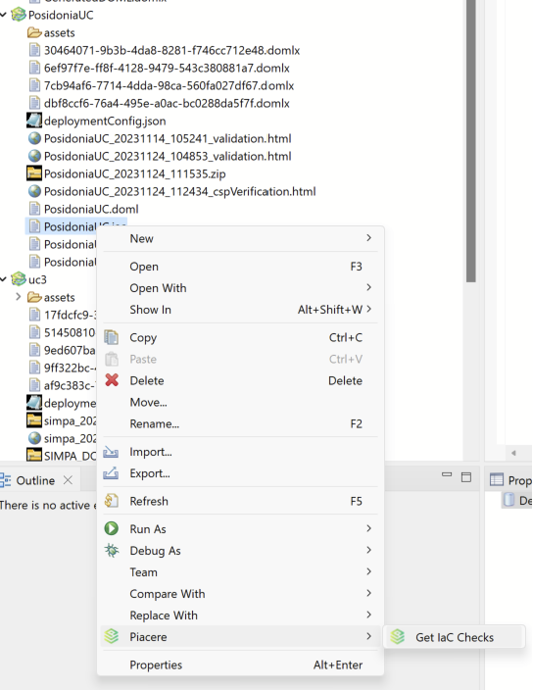
WHAT?
Design Time Security
Regain trust in IaC through the DOML verification and the automation of IaC code quality checking for errors and vulnerable dependencies, and thus improving IaC integrity and applicability
FASTER MALFUNCTIONING DETECTION
DECREASED RESPONSE TIME
MINIMIZATION OF DATA LOSS
^{www.piacere-project.eu}
^{@PIACEREproject}
^{@PIACERE project H2020}
^{@PIACERE project}
^{@PIACERE}
^{@PIACERE}

Slide 8
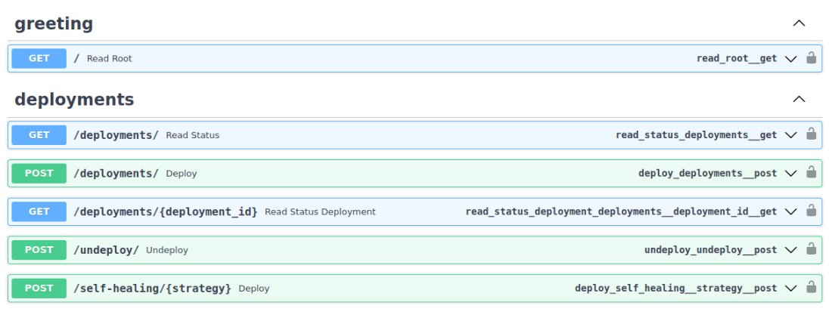
WHAT?
IaC Execution Manager
Avoid vendor lock-in and time consuming manual processes in infrastructure management, while increasing resilience and supporting self-healing
EFFICIENT PROVIDER-SPECIFIC IaC WRITEUP
BETTER DEPLOYMENT AGILITY
WORKFLOW AUTOMATION
^{www.piacere-project.eu}
^{@PIACEREproject}
^{@PIACERE project H2020}
^{@PIACERE project}
^{@PIACERE}
^{@PIACERE}

Slide 9
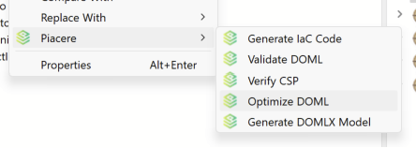
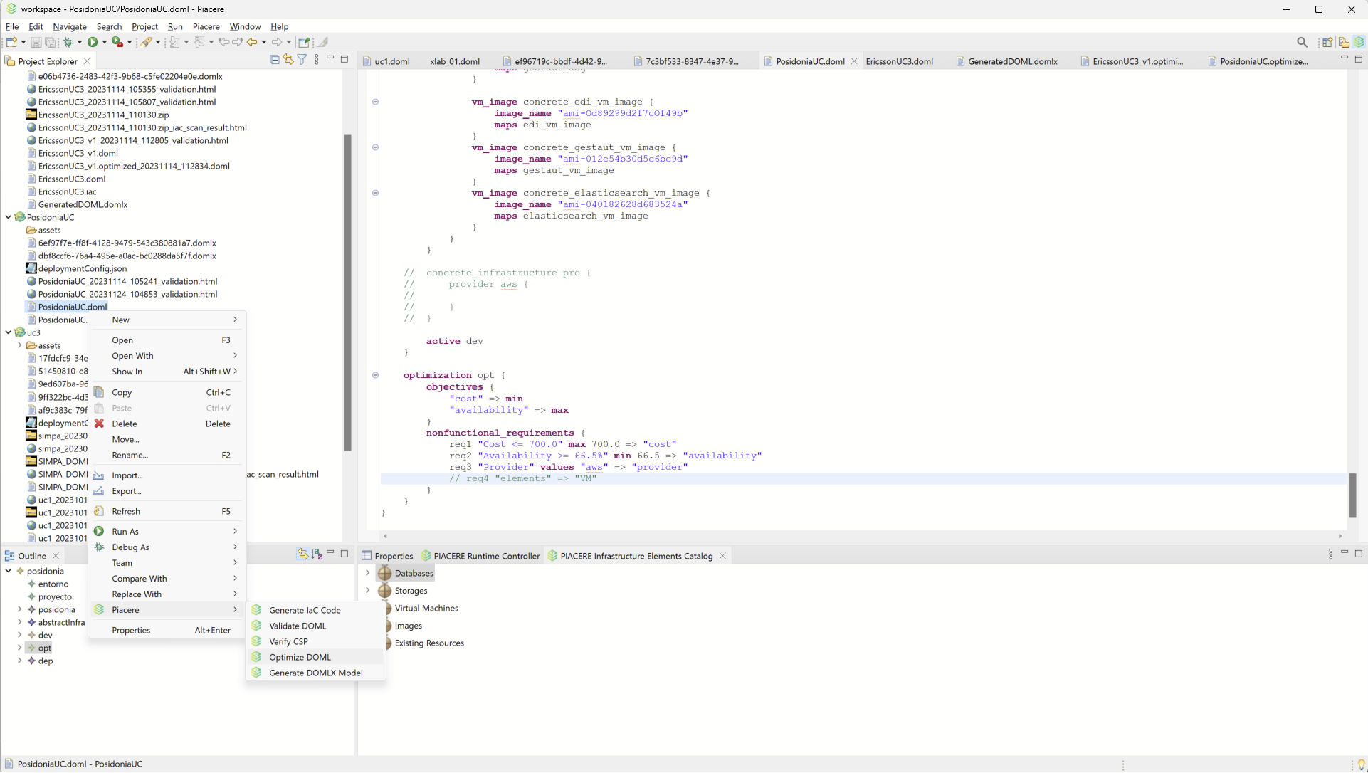
WHAT?
IaC Optimized Platform
Perform the most appropriate deployment configurations that best meet your defined constraints out of DevSecOps catalogue of services, resources and infrastructural elements by means of optimization algorithms.
COST, PERFORMANCE AND AVAILABILITY OPTIMIZATION
TAKES IN CONSIDERATION USER REQUIREMENTS
FLEXIBILITY TO ADDITIONAL OBJECTIVES & REQUESTS
^{www.piacere-project.eu}
^{@PIACEREproject}
^{@PIACERE project H2020}
^{@PIACERE project}
^{@PIACERE}
^{@PIACERE}

Slide 10
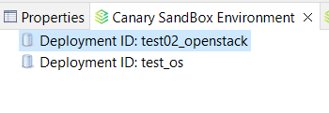
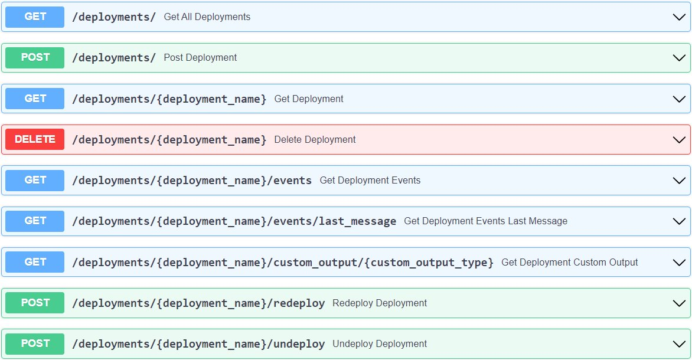
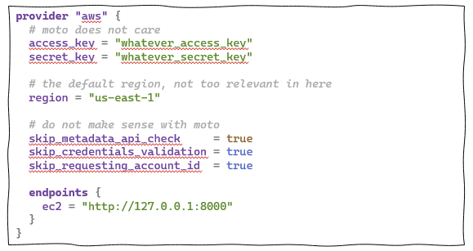
WHAT?
Canary Sandbox Environment
Allow unit testing of the behaviour of the infrastructural code on an isolated environment, which would enable the simulation of conditions for the production environment and identify some of the most common anti-patterns
EASE OF PREPARATION AND DEPLOYMENT OF ENVIRONMENT
CUSTOMISATION OF TESTING ENVIRONMENTS
EARLY IDENTIFICATION OF ISSUES ON IAC
^{www.piacere-project.eu}
^{@PIACEREproject}
^{@PIACERE project H2020}
^{@PIACERE project}
^{@PIACERE}
^{@PIACERE}

Slide 11
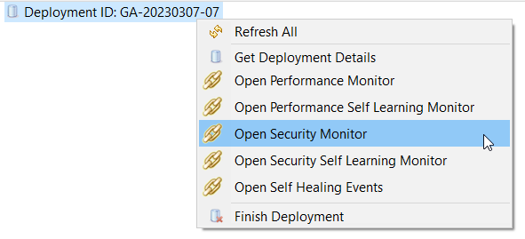
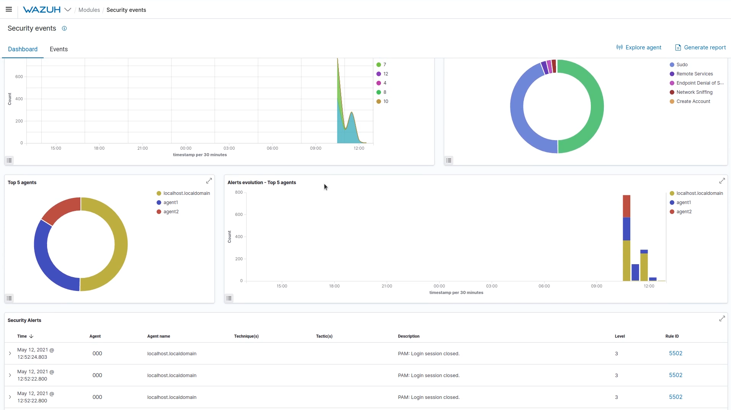
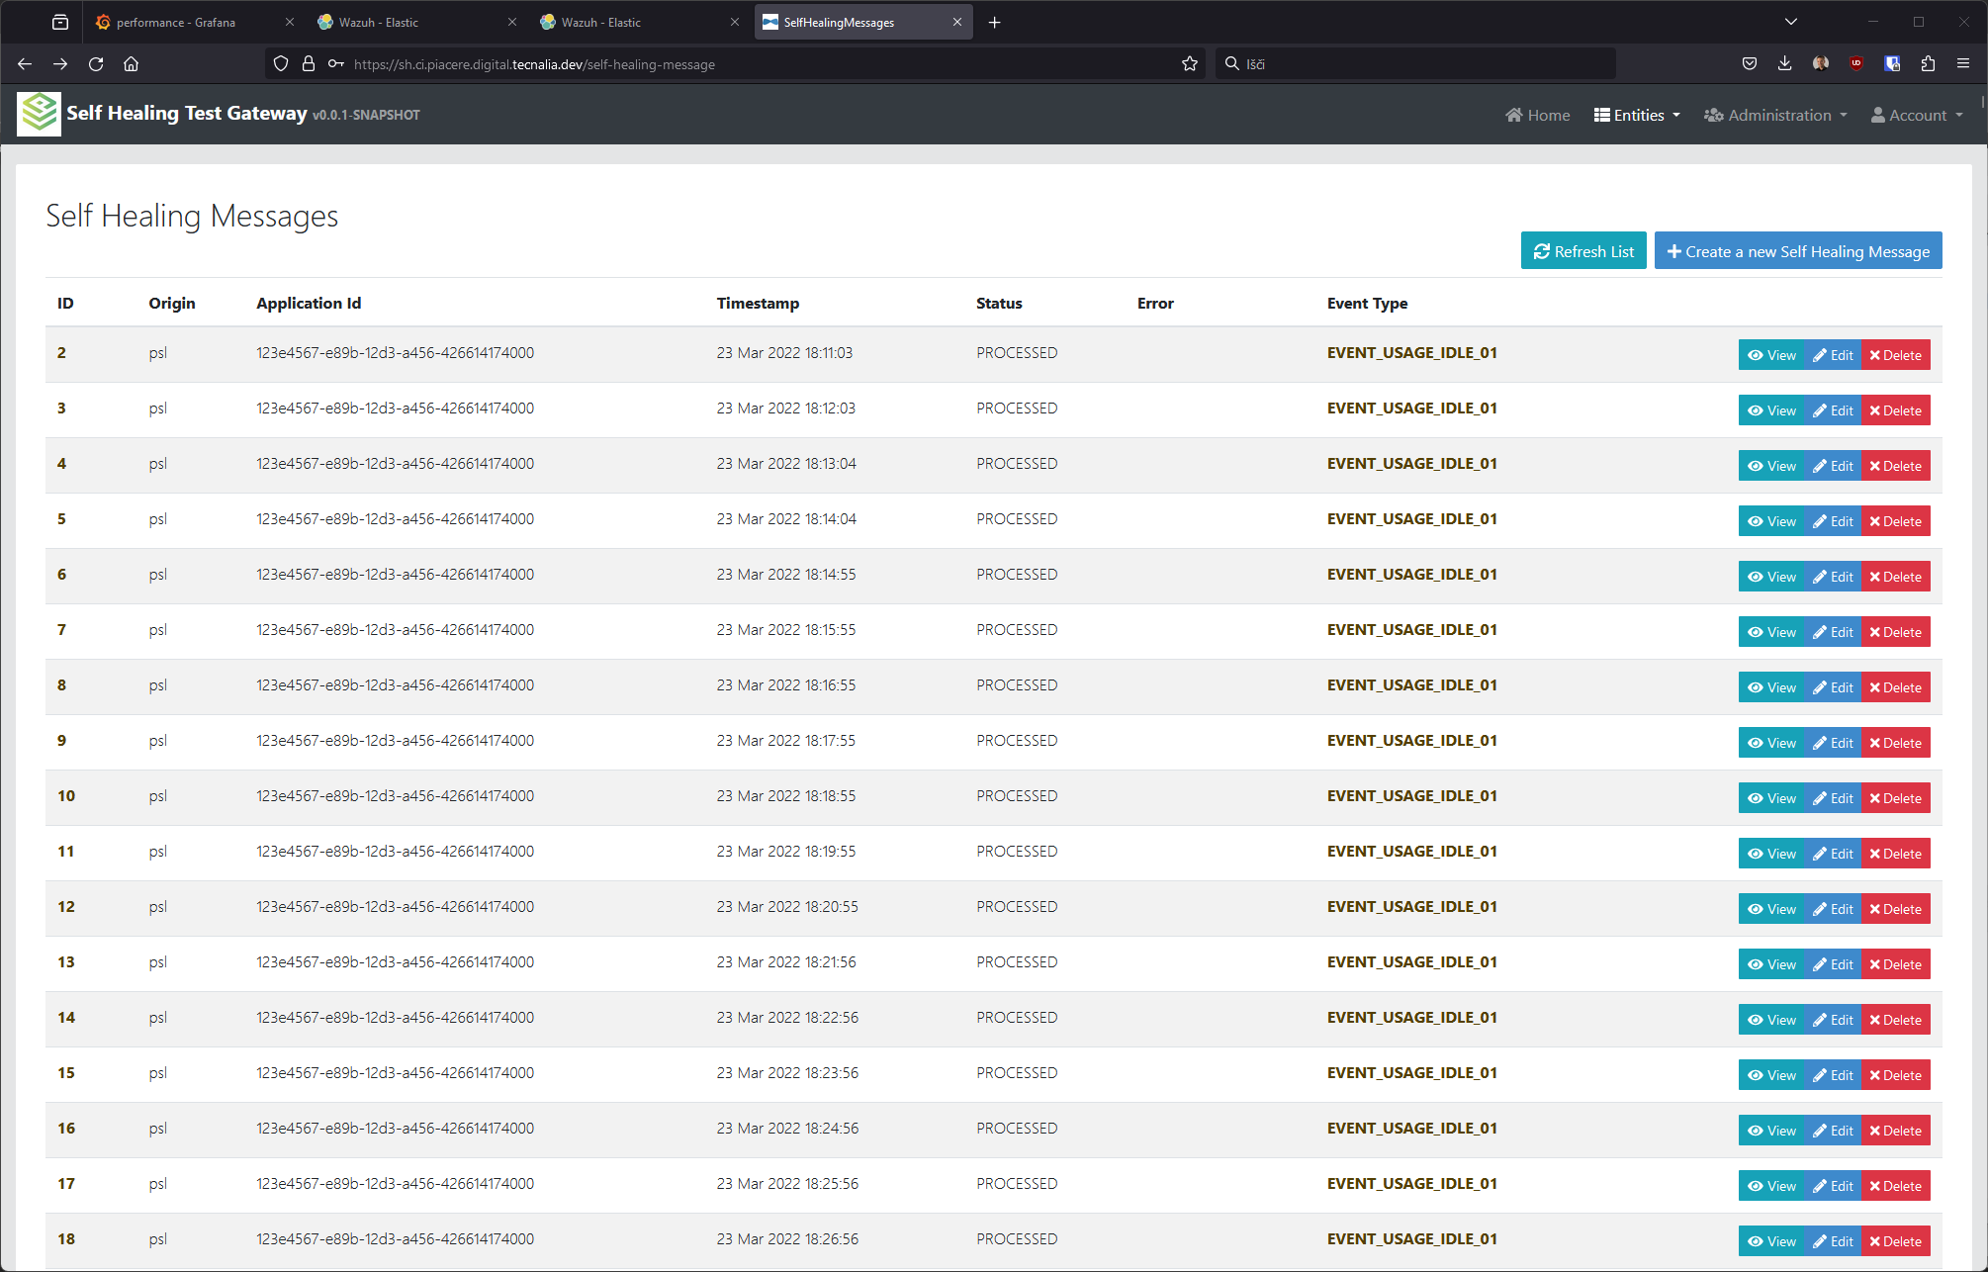
WHAT?
Runtime Security Monitoring
Ensure that the conditions of the QoS are met at all times and that a failure or non-compliance of NFRs is not likely to occur, with verified security violations at runtime
DEPLOY SECURITY AGENTS AUTOMATICALLY
AUTOMATE DETECTION AND INCIDENT RESPONSE
INTEGRATE WITH EXISTING SDLC SUPPORTING PROCESSES
^{www.piacere-project.eu}
^{@PIACEREproject}
^{@PIACERE project H2020}
^{@PIACERE project}
^{@PIACERE}
^{@PIACERE}

Slide 12
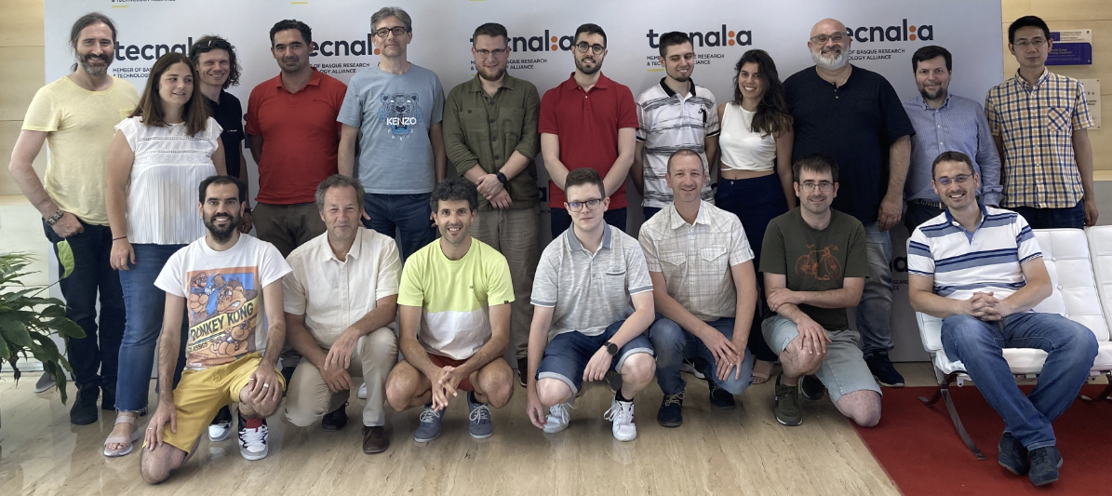
Thank you!
www.piacere-project.eu // Contact: joao.pitacosta@xlab.si

