Slide 1
EUCloudEdgeIoT.eu RIA Showcase
March 26
Tarik Zakaria Benmerar
ICT-FI
EUCloudEdgeIoT.eu RIA Showcase
26/03/2024

Slide 2
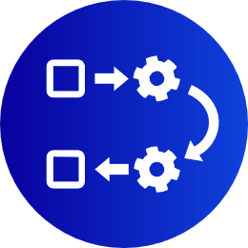
CHARITY Objectives
Achieve autonomicity in orchestrating network, compute, and storage resources in hybrid edge/cloud infrastructures.
Provide holistic support for the orchestration of advanced media solutions.
End-to-end application lifecycle management.
Develop highly interactive and collaborative services and applications.
Augment project visibility, outreach and business sustainability

Slide 3
CHARITY Consortium

Slide 4
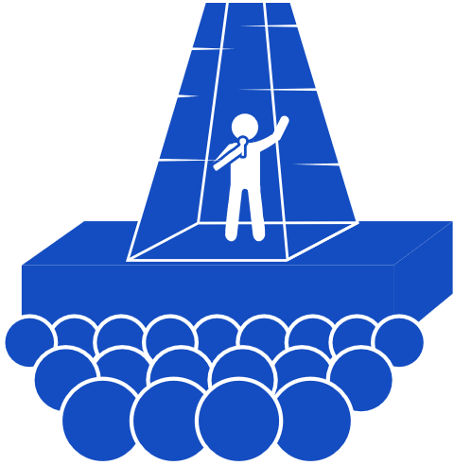
CHARITY use cases
Virtual reality Medical training
Holographic Concert
Holographic Meeting
Collaborative Gaming
Manned-Unmanned operations trainer
Virtual reality Tour Creator

Slide 5
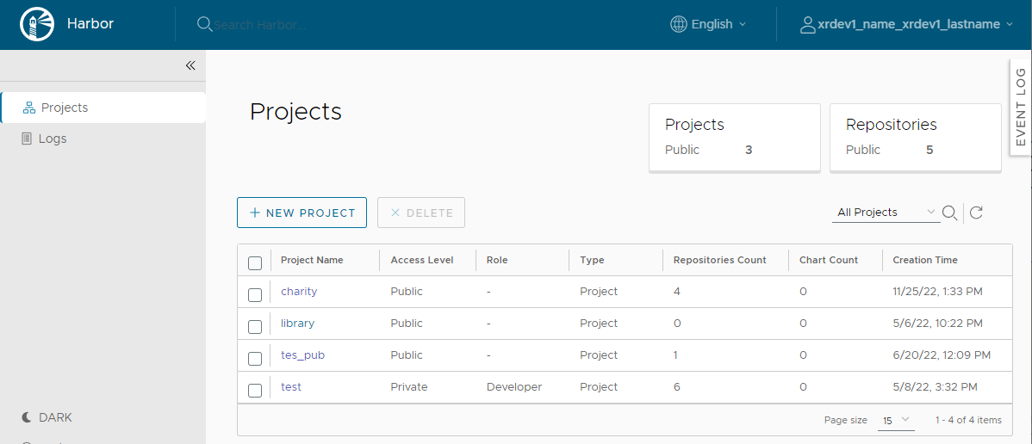
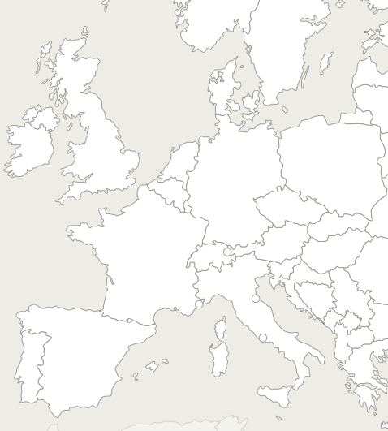
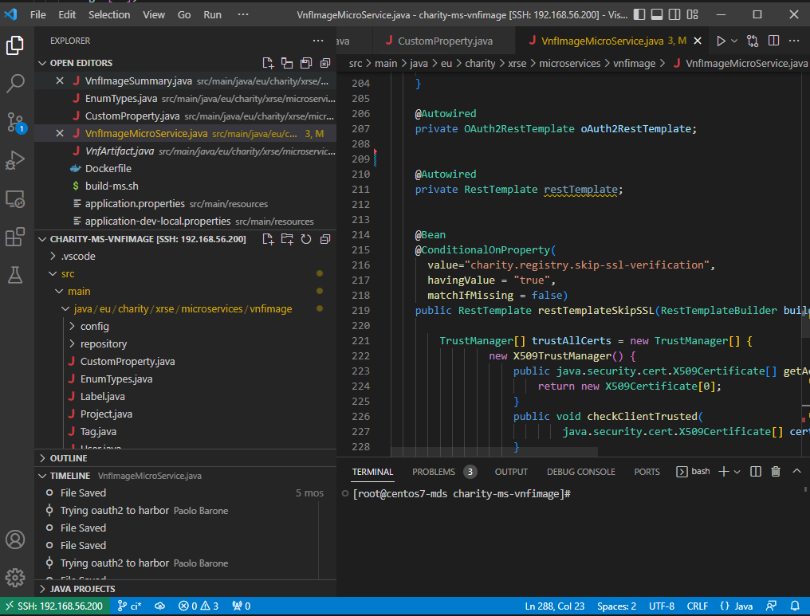
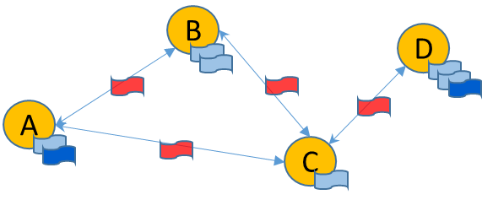
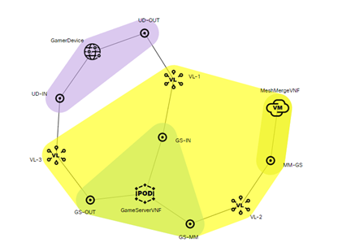
Charity approach: XR development to deployment
Charity XR Developer
Charity AMF
Charity Orchestration
RES
PROX
ADAPT
ENAB
SEC
aws
App component
code
App component image
XR service enabler repository
build&package
ENAB
azure
write
edge
Add to XR
repository
edge
user
Edit XR model
Blueprint Template editor
App component (VNF)
Input params
Deploy XR
model
Communication links
Deployment
hints
QoS requirements
RES
PROX
MON
Actual
Input
Values
Tosca Model
Charity Monitoring
Deploy
PRED
Charity Forecasting

Slide 6
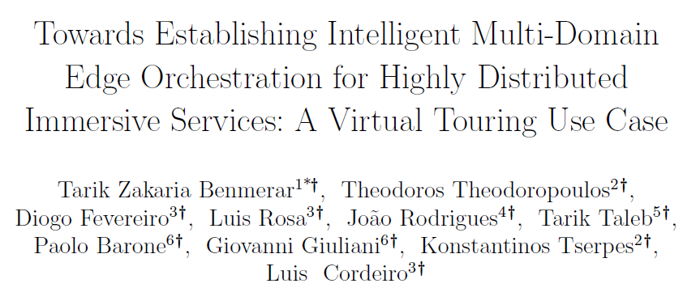
Two related publications
IEEE iEDGE 2023
Cluster Computing Journal – Accepted for publication

Slide 7
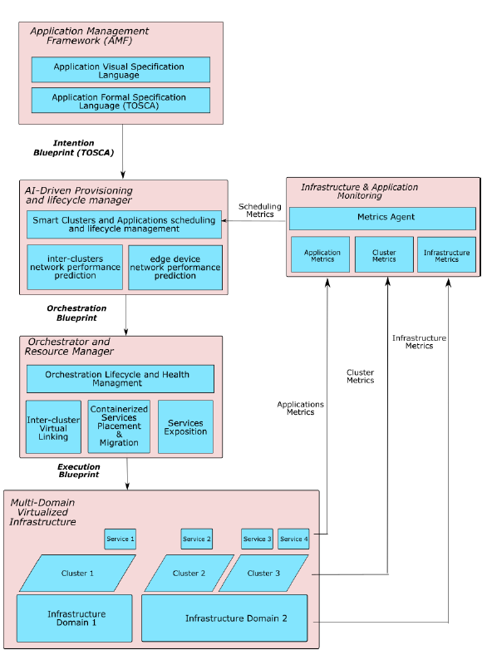
Two related publications
Main Architecture
Contribution

Slide 8
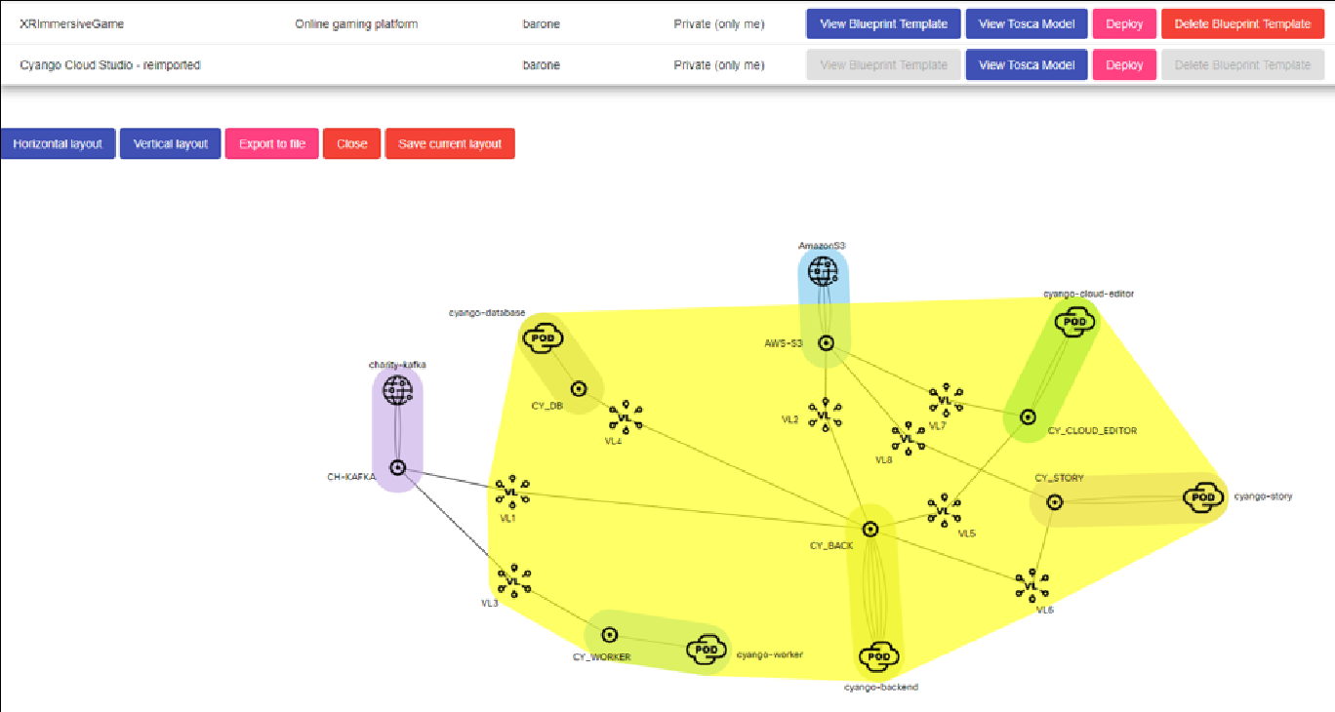
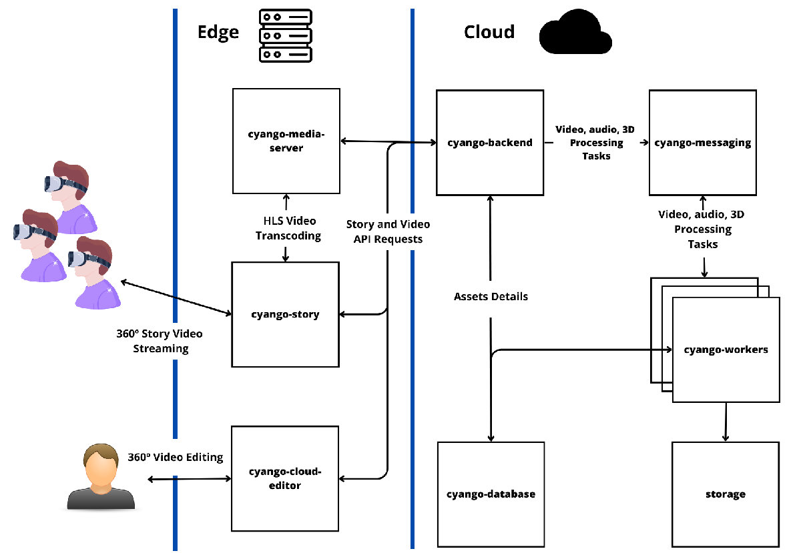
Expressing user intents
AMF visual language for expressing the application.
AMF Cyango visual representation
Cyango Components Architecture

Slide 9
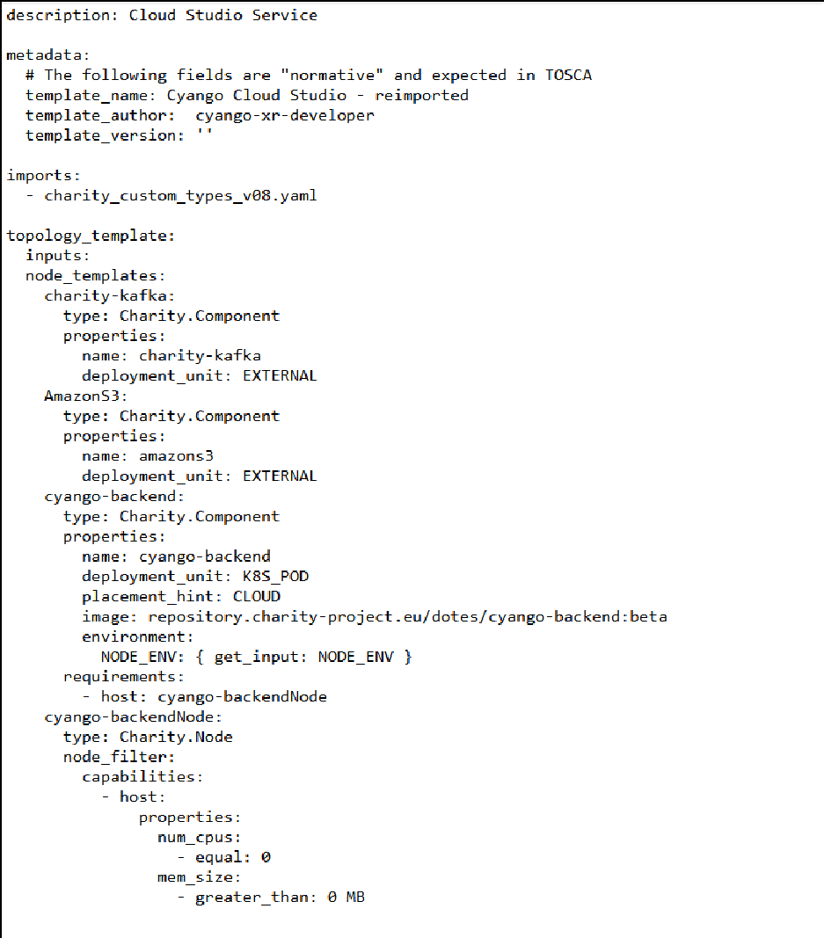
Expressing user intents
TOSCA : The formal language for application topology specification.
Expressing the Application Topology in abstract YAML format.
Extending the standard with multi-domain specific types.

Slide 10
Expressing user intents
Enriching TOSCA with new types in CHARITY:
Charity Nodes with GPU capability.
Charity Components with placements constraints.
Charity ConnectionPoints and Ports.

Slide 11
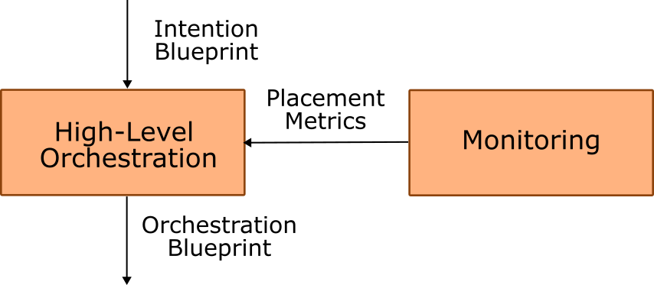
The missing component
The High level Orchestrator generates the required orchestration blueprint from the intention blueprint.
Decision-making centric.
Simple interfaces with document-only payloads.
AI algorithms can be integrated in a simple manner.

Slide 12
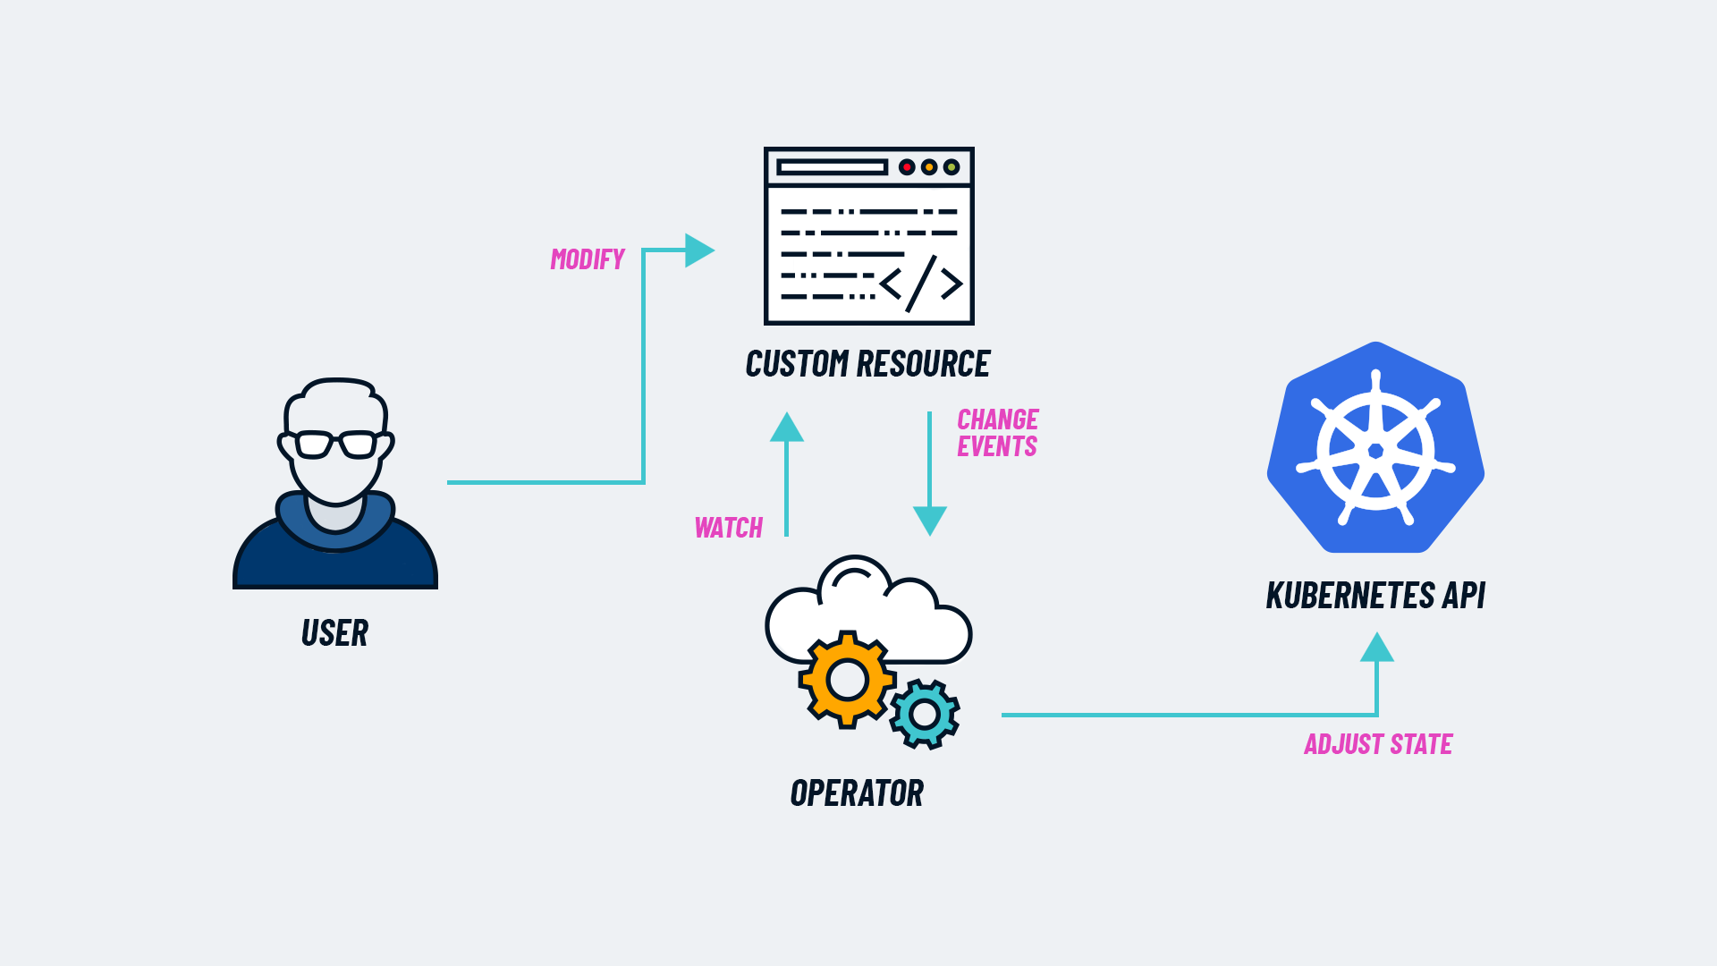
Orchestration Lifecycle and Health Management
Operators paradigm for low-level orchestration.
The orchestration component receives an orchestration blueprint through a Custom Resource.
It updates with infrastructure Blueprints.
It ensures the right infrastructure status.

Slide 13
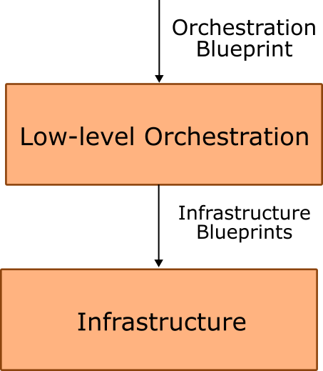
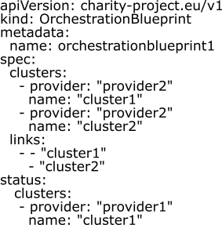
Orchestration Lifecycle and Health Management
A Custom Ressource for orchestration blueprint.

Slide 14
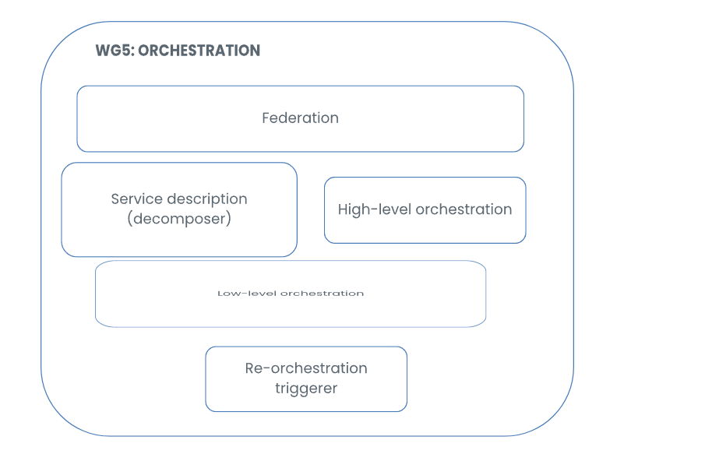
The new paradigm in EUCloudEdgeIoT.eu TF3 WG5
The EUCloudEdgeIoT.eu TF3 WG5 has agreed on the functional view of orchestration building block architecture and follows our proposed paradigm.
EUCloudEdgeIoT.eu

Slide 15
Thank you for your attention!
www.charity-project.eu
@CharityProj
Acknowledgment: The research conducted by CHARITY receives funding from the European Commission H2020 programme under Grant Agreement Nº 101016509. The European Commission has no responsibility for the content of this presentation.

