Slide 1
CEI talk
March 26, 2024
A DevOps approach for AI applications at the edge
The AI-SPRINT Solution
Danilo Ardagna
danilo.ardagna@polimi.it
AI-SPRINT: Artificial Intelligence in Secure PRIvacy-preserving computing coNTinuum

Slide 2
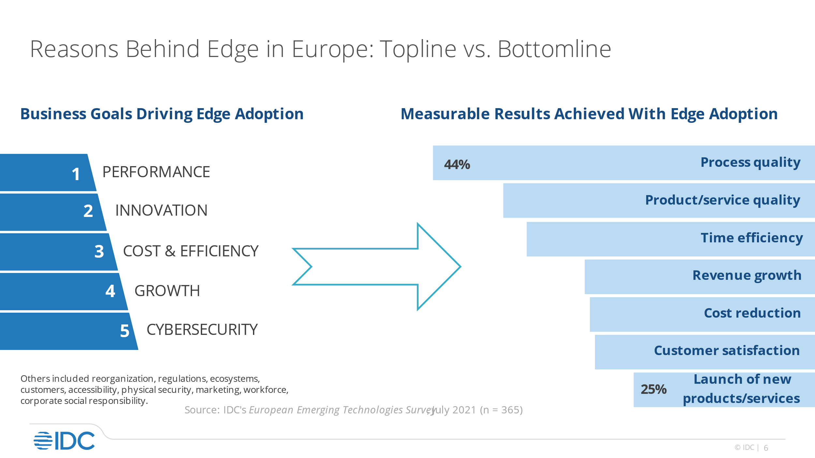
European Edge Market Overview
European organizations are already using edge technologies
and this number is expected to double over the next two years
European Enterprise Edge spending in Europe approaching
$33B
Cloud Services*
(by 2026)
23%
Artificial Intelligence* at the edge (by 2026)
12%
*share of total Enterprise Edge spending
Source: IDC Research - WW Edge Spending Guide, August 2022; IDC - European Edge Market forecast 2022-2027, Oct 2023
Notes:
EDGE overview of edge market (right end)plus main drivers to use edge computing
AI is expected to become an increasingly important component of edge computing over the forecast period, with this market segment doubling in value by 2027.
Service providers will account for nearly 25% of the total European edge spending by the end of 2027 posting a five-year CAGR of 18%

Slide 3
AI-SPRINT problems solved
Delivering AI applications at the edge
Provide performance guarantees to applications
Secure application and data

Slide 4
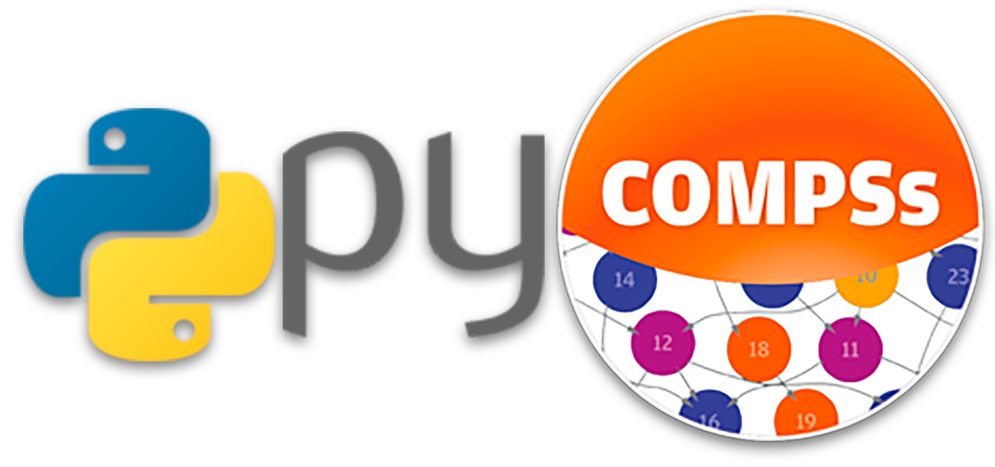
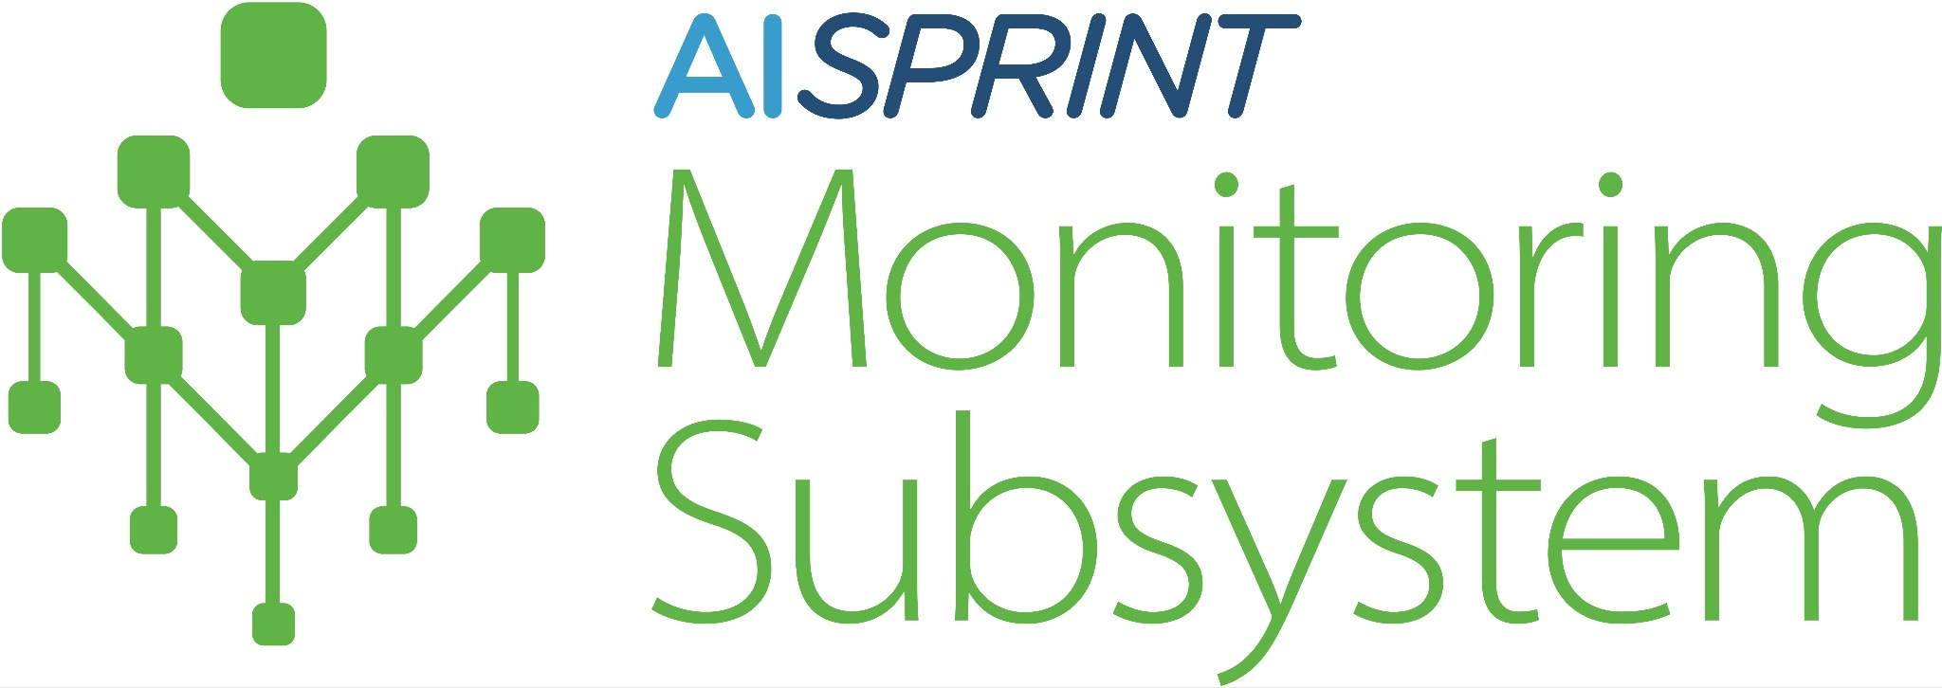
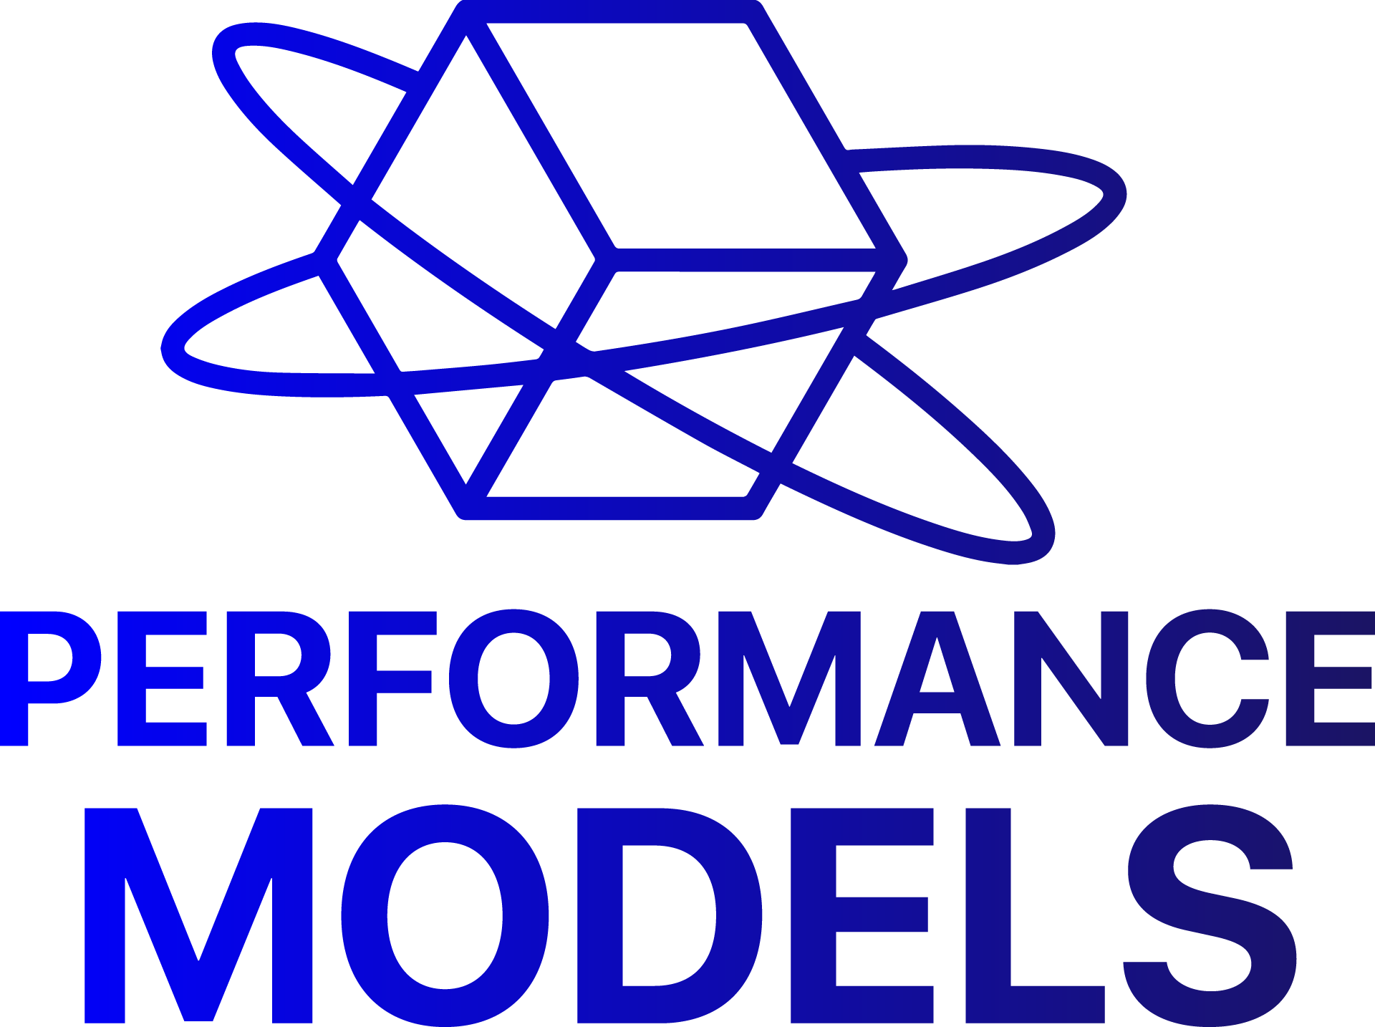
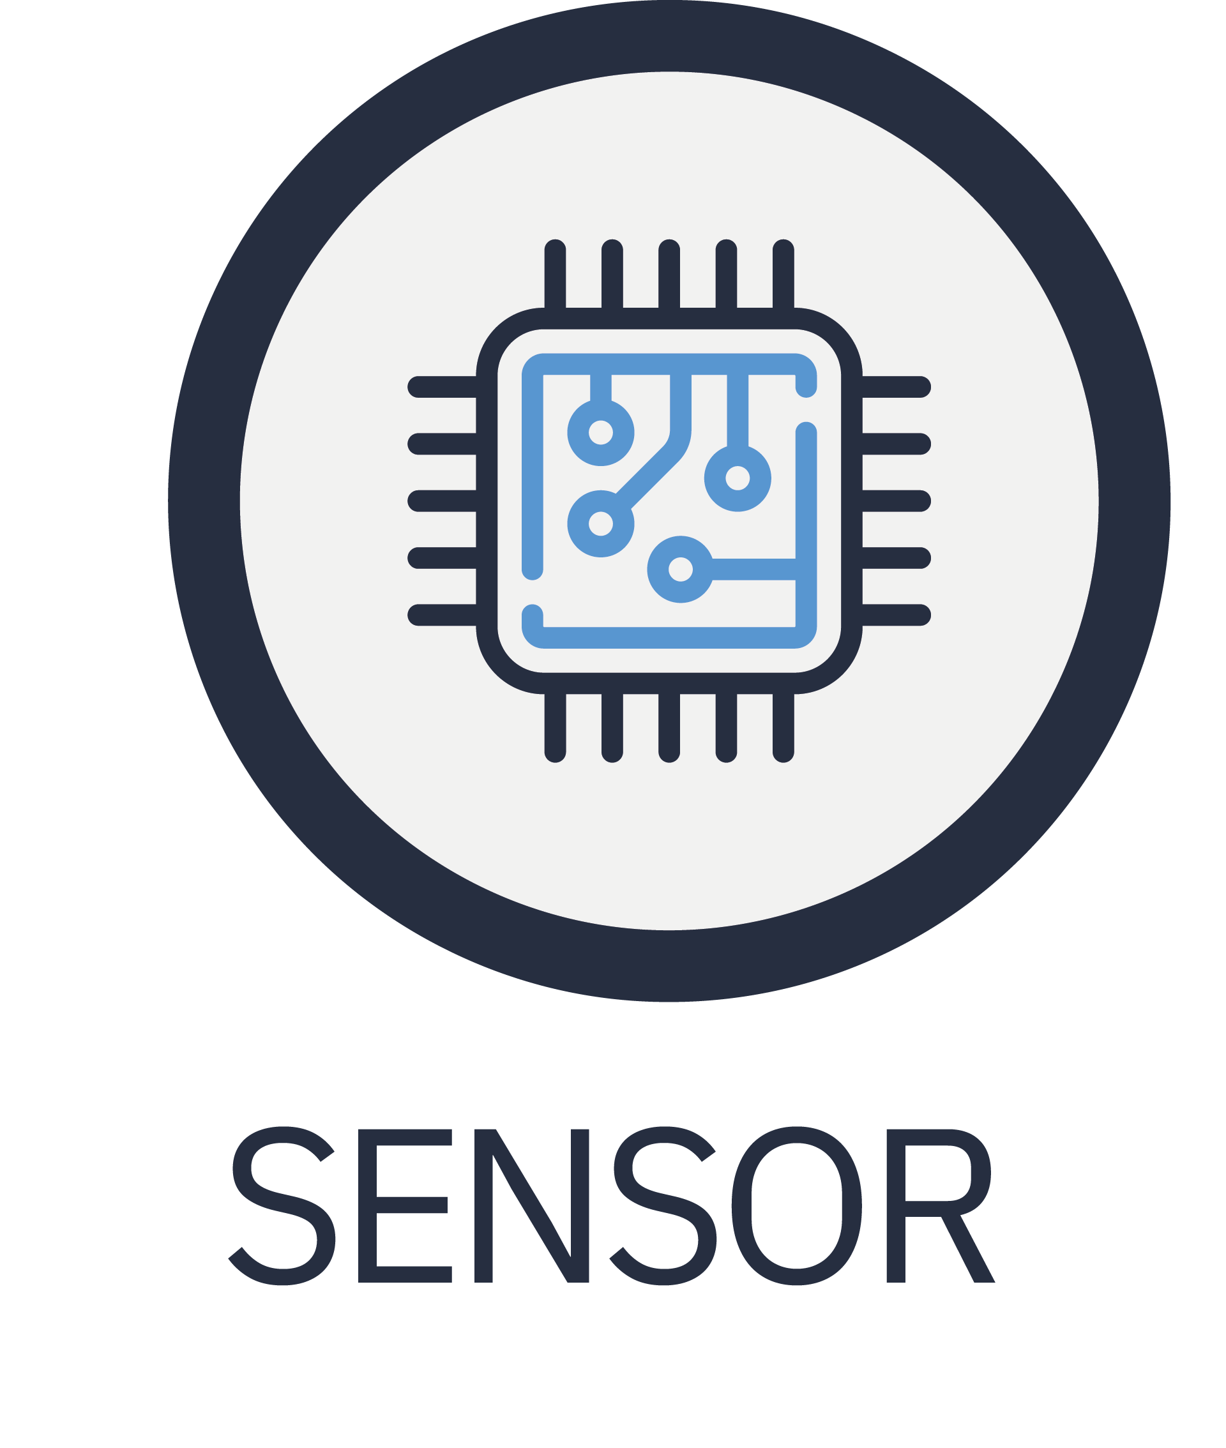
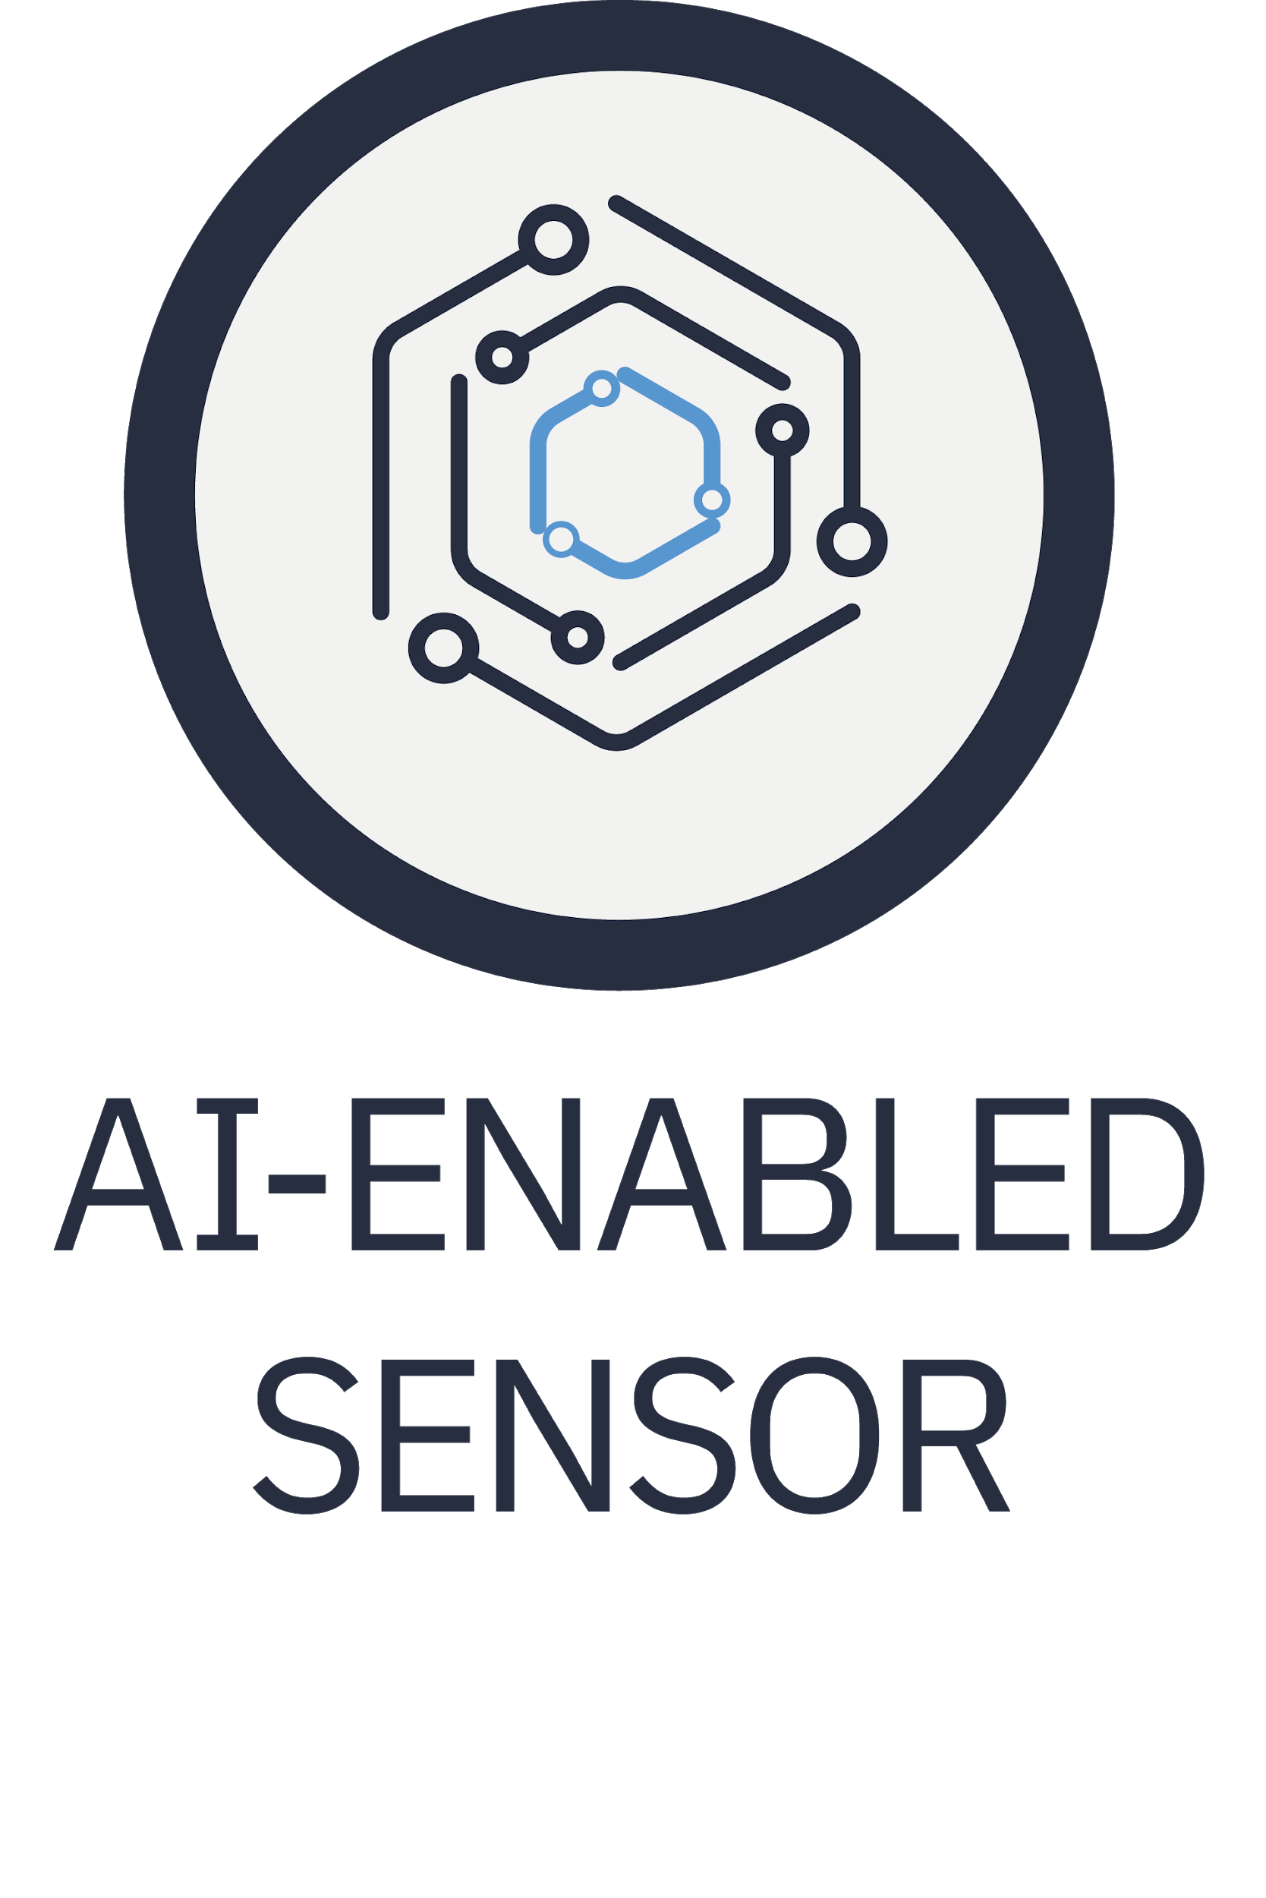
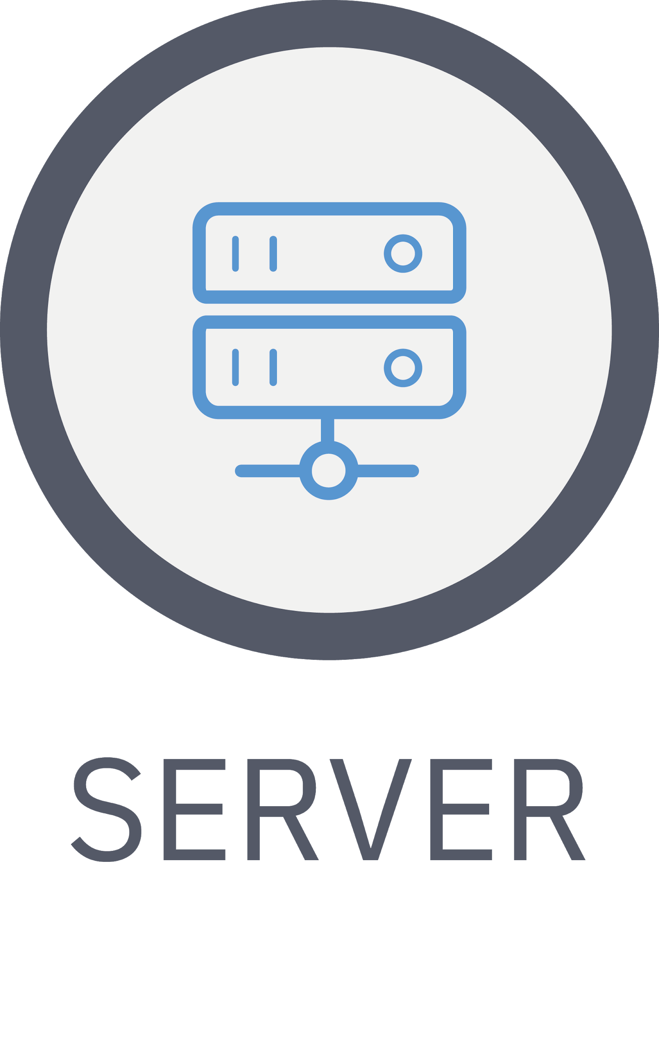
AI-SPRINT toolchain
AI-SPRINT Studio
AI-SPRINT Runtime
Krake
Application
Developers
Infrastructure
Provider & Sysops
OSCAR-P
SCAR
Runtime
Infrastructure Manager
Cloud Provider API
VMs Cluster/Containers
Application
Manager
End User
Notes:
Automated deployment and dynamic reconfiguration
Secure execution of AI applications
Highly specialized building blocks for privacy preservation, distributed training, and architecture enhancement
Open source
Add obj to the figure
Sustainability

Slide 5
AI-SPRINT toolchain
AI-SPRINT Studio
AI-SPRINT Runtime
Krake
Application
Developers
Infrastructure
Provider & Sysops
OSCAR-P
SCAR
Runtime
Infrastructure Manager
Cloud Provider API
VMs Cluster/Containers
Application
Manager
End User
Notes:
Automated deployment and dynamic reconfiguration
Secure execution of AI applications
Highly specialized building blocks for privacy preservation, distributed training, and architecture enhancement
Open source
Add obj to the figure
Sustainability

Slide 6
AI-SPRINT toolchain
AI-SPRINT Studio
AI-SPRINT Runtime
Krake
Application
Developers
Infrastructure
Provider & Sysops
OSCAR-P
SCAR
Runtime
Infrastructure Manager
Cloud Provider API
VMs Cluster/Containers
Application
Manager
End User
Notes:
Automated deployment and dynamic reconfiguration
Secure execution of AI applications
Highly specialized building blocks for privacy preservation, distributed training, and architecture enhancement
Open source
Add obj to the figure
Sustainability

Slide 7
AI-SPRINT toolchain
AI-SPRINT Studio
AI-SPRINT Runtime
Krake
Application
Developers
Infrastructure
Provider & Sysops
OSCAR-P
SCAR
Runtime
Infrastructure Manager
Cloud Provider API
VMs Cluster/Containers
Application
Manager
End User
Notes:
Automated deployment and dynamic reconfiguration
Secure execution of AI applications
Highly specialized building blocks for privacy preservation, distributed training, and architecture enhancement
Open source
Add obj to the figure
Sustainability

Slide 8
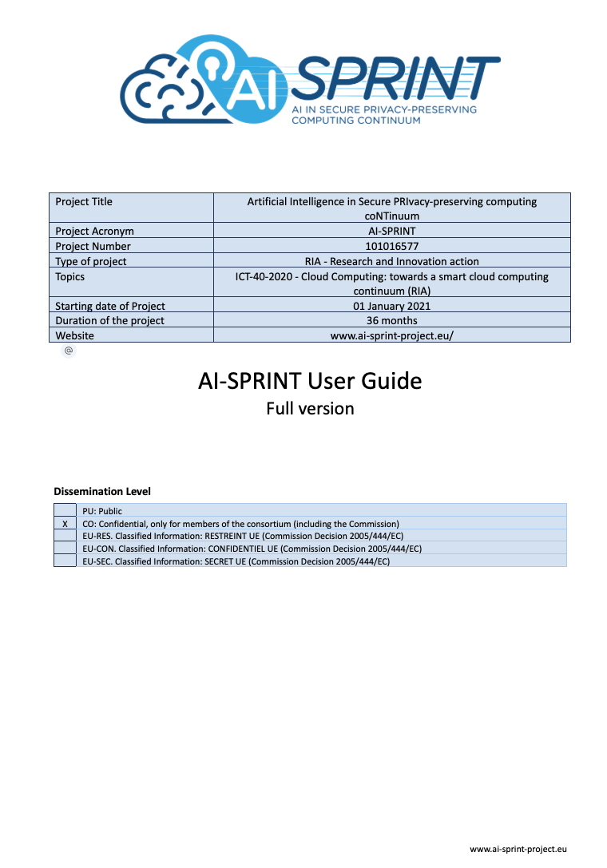
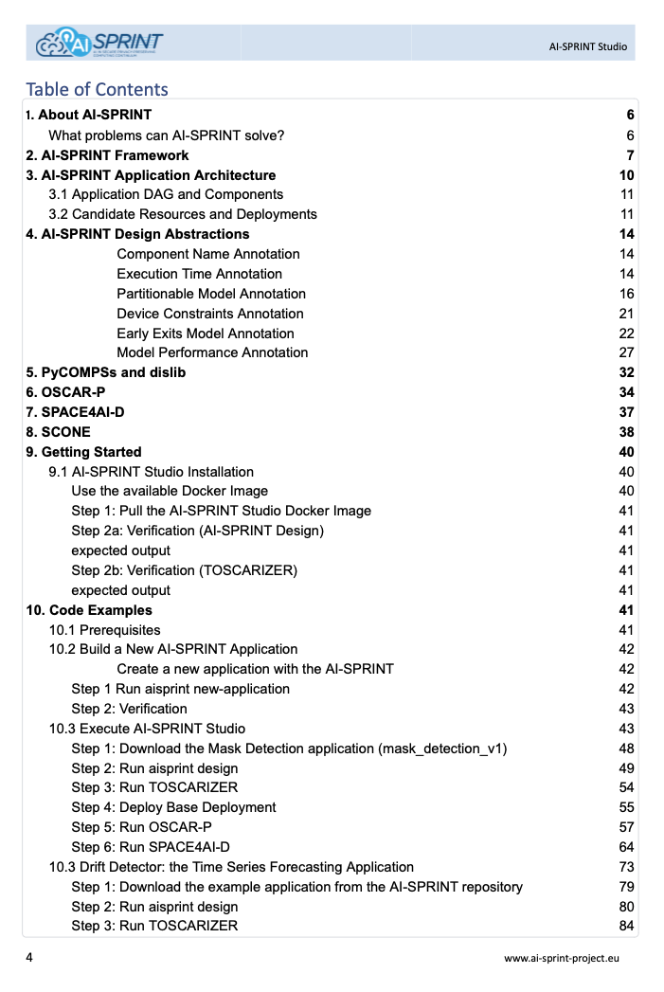
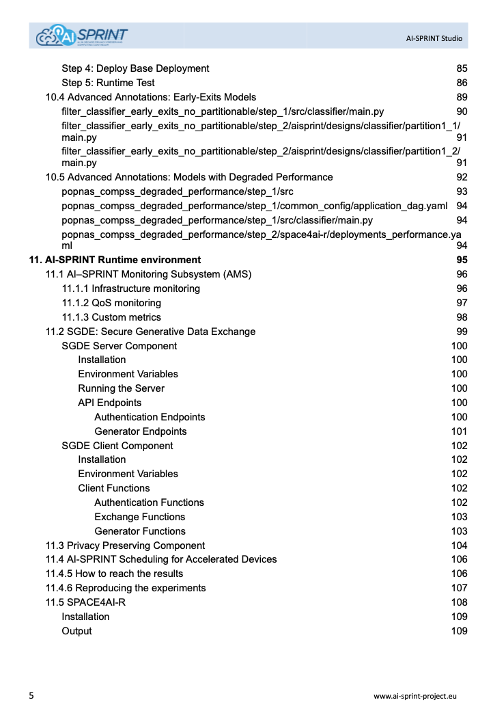
AI-SPRINT Documentation
Comprehensive documentation to facilitate user adoption
Initial (open) vs Detailed (upon agreement)
Step-by-step guided examples on the user-facing components
Each internal component has its documentation in the corresponding GitLab / GitHub repository
https://www.ai-sprint-project.eu/

Slide 9
AI-SPRINT: Use cases
Notes:
simplified programming models to reduce the steep learning curves in the development of AI software in computing continua; ii) highly specialized building blocks for distributed training, privacy preservation and advanced machine learning models, to shorten time-to market for AI applications; iii) automated deployment and dynamic reconfiguration to decrease the cost of operating AI software.

Slide 10
Thanks for your attention…
?
?
?
…any questions?

