Slide 1
Edge-to-Cloud Solution Acceleration Platform
Required to Electrify the World
Mats Olsson
General Manager Pratexo EMEA
mats.olsson@pratexo.com

Slide 2
Cloud
Agnostic
Edge-to-Cloud
Solution Platform
Integrated Grid Monitoring & Analytics
Distributed EV Charging Management
Power Balancing with FFR
Root Cause Analysis Expert System
3rd Party Solutions
Custom Solutions
Pratexo
Solution
Frameworks
Designs
Simulates
Deploys
Manages
Monitors
Pratexo Studio
Pratexo
Edge-to-Cloud PaaS
Pratexo Core
OS Agnostic
Hardware Agnostic
Network
Agnostic
Device Agnostic

Slide 3
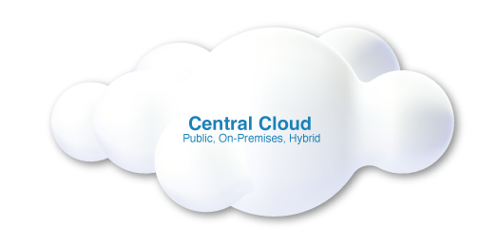
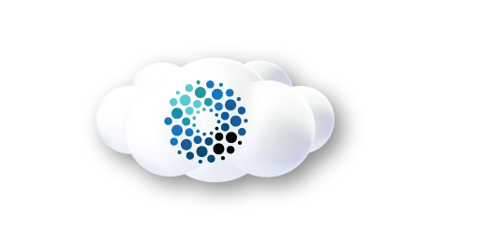
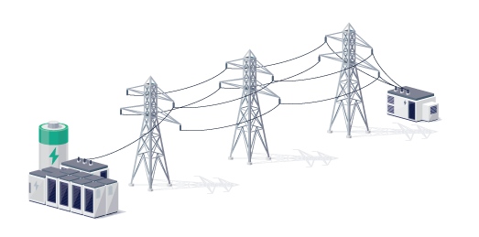
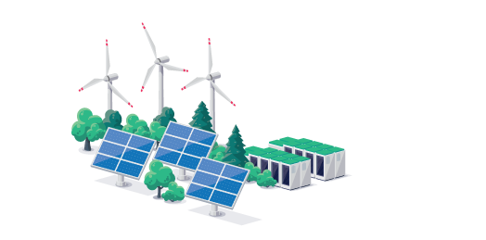
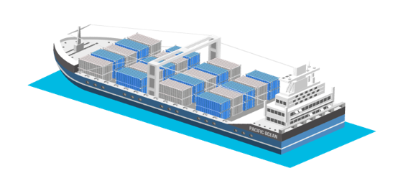
Interested in learning more? Contact caroline.olsson@pratexo.com
Hybrid Edge-to-Cloud Computing
Pratexo Edge Node
Pratexo Micro Cloud
Central Cloud
Only the right data is pushed to central clouds for long-term storage, reporting, analysis, and AI model training
Multi Level
Different situations may require multiple levels of micro clouds
Micro Cloud
Edge nodes combine to create local micro clouds that are highly scalable and resilient
Edge Nodes
Multiple Pratexo compute nodes run at the far edge

